Slide 1

Legislative Process & Context
2020

Slide 2
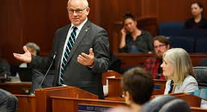
31st Legislature
2nd Session

Slide 3
Introduction of Bills
Bills may be pre-filed before January 1. A member may pre-file up to 10 bills (Uniform Rule 36)
No bill may be filed after the 35th day of second session (Uniform Rule 44)
Bills may be introduced by a legislator, standing or special committee, joint committee, or the Governor (Uniform Rule 37)

Slide 4
How do we know what bills to follow?
Currently 90 bills bills that might affect education are “in play”
Who introduced the bill?
How many committees of referral?
What committees of referral?
Committee Chairs are VERY powerful!

Slide 5
2020 Legislative Context
Three Budgets that affect Education: Operating, Capital, Mental Health
What’s driving the Legislature in 2020?
Revenue
Budget Shortfalls
PFD
Forward Funding of Education

