Slide 1
Good Governance VS Management; It’s Easier Said than Done!
Dr. Karen Gaborik, Superintendent Fairbanks North Star Borough School District
&
Michael Swain, President AASB and President Bristol Bay School Board
Notes:
Welcome participants

Slide 2

What is governance
What is management
What is a sign that you have crossed the line?
Notes:
Small groups
1. Discuss the questions
2. Board members: Think of a time that you have found yourself crossing the line from governance to management or you have seen a fellow board member attempting to manage.
Brave souls to share out? (Just one or two.)
(If none: Superintendents—in a district long ago and far away: Any examples?)

Slide 3

Governance and Management
Governance: Focused on the system
Management or micro- management: Focused on individual or department actions

Slide 4
Notes:
Mike: Top half
Karen: Bottom half

Slide 5
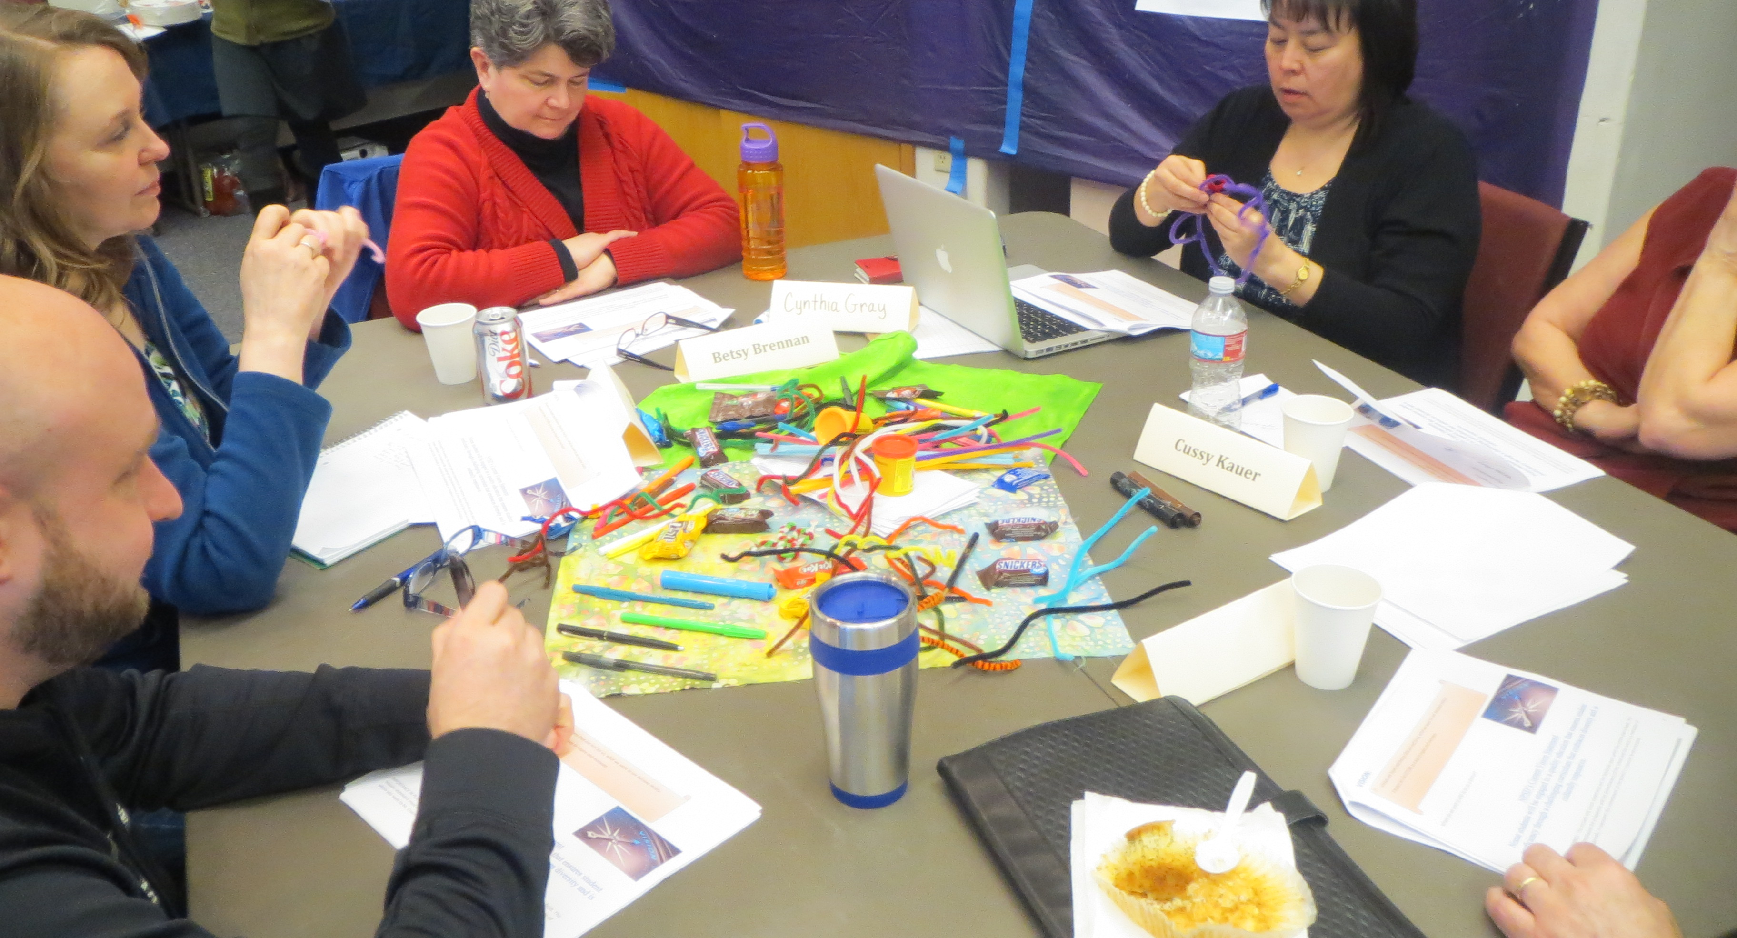
Talk at Tables!
Notes:
Divide the room in half.
Half A: Review the General Functions page. What are the key differences between the Board and the Superintendent?
Half B: Review the Expectations and Relationships page: What are the key differences between the Board and the Superintendent?
All: When do you know that you’ve crossed the line?
Each Table Report Out: 1 highlight from your assigned page and 1 example of crossing the line.

Slide 6
General Functions!
Board Governance
Superintendent
Management
Governs the district; hires the superintendent, establishes system expectations, and evaluates self and the superintendent.
Advises the Board, is the chief executive officer of the district, is the Board’s ONLY employee.
Notes:
Mike & Karen

Slide 7

Expectations and Relationships
Board Governance
Superintendent
Management
Notes:
Mike & Karen

Slide 8
Table Assignments
Policy
Budgets / Finance
Curriculum & Instructional Material
Personnel
Collective Bargaining
Students
Facilities
Meetings
Community Engagement & Relations

Slide 9
Activity
One real example of when things have gone very well with the board and superintendent roles.
One real example of when things have not gone well.
How did/would you solve the issue?
On your poster paper: Draw a picture
  What it looks like when it’s awesome!
  What it looks like when we’re struggling.
  How we can fix it!

Slide 10

Policy
Superintendent
Management
Board Governance
The WHAT.
Review policy recommendations from Superintendent, debate, adopts.
The HOW.
Recommend policies to the board. Responsible for how they are implemented.

Slide 11

Budget and Finance
Board Governance
Superintendent
Management
Establish priorities, approve, adopt, monitor.
Prepares, administers, monitors and audits details.

Slide 12
Curriculum and Instructional Material
Board Governance
Superintendent
Management
Recommends, oversees staff efforts, evaluates
Establishes criteria, approves, monitors

Slide 13

Personnel
Board Governance
Superintendent
Management
The WHAT
The HOW

Slide 14
Collective Bargaining
Board Governance
Superintendent
Management
Ensure process is followed within the CBA guidelines
Provides goals, ratifies contracts

Slide 15

Students
Board Governance
Superintendent
Management
Adopts
policies
for
care and control
Recommends, implements, directs

Slide 16
Facilities
Board Governance
Superintendent
Management
Develops policies on use
Implements policy, writes procedures, makes recommendations

Slide 17

Meetings
Superintendent
Management
Board Governance
President or chairperson is in charge of meetings
Serves as a resource to the board

Slide 18
Community Engagement and Relations
Board Governance
Superintendent
Management
Creates a positive image of the district
Creates a positive image of the district and directs communication

Slide 19

Good questions to ask
Am I acting within the policies established by the board, specifically our board bylaws?
Am I focused on what is good for ALL kids?
Am I as an individual governing or is the board as a whole?
Are we allowing our educational leader, our only employee, the superintendent to do the job he/she was hired to do?
Notes:
Mike

Slide 20

Thanks for Attending!
The AASB Board Development Team is here to help at anytime!
Timi Tullis, Lon Garrison or Rich Carlson
ttullis@aasb.org
Lgarrison@aasb.org
rcarlson@aasb.org
907-463-1660
Thanks so much to Dr. Karen Gaborik for assisting with this presentation.

