Slide 1
Your Role in the Budget Process; What You Need to Know
Rich Carlson
Board Support and Training Coordinator
AASB

Slide 2
It is the Boards job to approve the budget (and budget revisions) based on district goals, priorities and the strategic plan.
It is the superintendent’s job to manage the budget.

Slide 3

Focus
To provide a general understanding of the budget process.
Budget terms, timing and the state foundation formula will be empathized.
Understanding the foundation may be especially important during this legislative session.

Slide 4
Revenues
Revenues are generally made up of:
State Foundation
Required local contribution (Impact Aide for REAA’s)
Federal Funds (like E-Rate) Note: these funds are generally restricted)
Misc.
  Local income
  Rent

Slide 5

Expenditures
Often much of the attention is on the expenditures side, the fact is most of the expenditures are predetermined.
In most districts about 80% to 85% of cost are in salaries and benefits (assuming a stable staff)
Another 5% to 10% are fixed costs such as heating fuel, property insurance and needed maintenance.
Only 5% to 10% is really discretionary.

Slide 6

Timeline
October Student Count
  20 days in October
  Always ending the last Friday in October (OASIS)
  Report due to DEED first week of November for Foundation Funding

Slide 7

Budgets are moving targets and need to monitored and revised
Notes:
December: 1st FY20 Budget Revision
January/Feb 2nd FY 20 Budget Revision
April/May: 3rd FY20 Budget Revision
End of June: Final FY20 Budget Revision

Slide 8

Estimates and Assumptions
All budgets require a certain amount of estimates/assumptions/projections such as:
      Can you provide some examples of what estimates and assumptions go into creating a budget?

Slide 9
Assumptions, Estimates and Projections
Examples of assumptions, estimates and projections:
  Enrollments
  Cost of Insurance
  BSA
  Depending on the year, outcome of negotiations
  Changes in state and federal regulations (possible unfunded mandates)
  Others

Slide 10
TYPES OF FUNDS (GASB-54)
•Non-Spendable
  -Examples: inventory, fuel, endowments
  • Restricted
  -Assigned a specific purpose by the provider.
  Example: grants and bond reimbursements
  • Assigned
  -Assigned a specific purpose by the action of the governing board. Example: capital projects, major maintenance, to be used for foreseeable future expenses
  • Unassigned
  -Need for general operations often known as the general fund (and subject to 10% carry-over restriction)

Slide 11

GENERAL BUDGETING TERMS
General Fund: comprised of the Foundation, local contribution, some federal funds (Impact Aid, E-rate), income, and miscellaneous local receipts.
Required Local Effort
The amount that cities and boroughs must contribute to local education.
Notes:
This may seem way into the weeds but this year this maybe especially important.
Gov looking at formula driven programs add 110million per year
Medicare and Education
IDEAS
Contest, who can define terms?
Lightening session

Slide 12
TERMS TO KNOW
  On-behalf
    In and Out funding of the retirement unfunded liability
  Supplanting
    Using Grant funds to pay for what had been paid out of the general fund
  District Cost Factor –Meant to address geographic cost differences (2005 ISER Study)
  Quality Schools Grant
    $16 per student
  BSA
  $5,930
  ADM
  Average daily membership (October 20 day count)
  School Size Factor
  Factor 0-10=no school: 10-100= 1 school: 101-425 = 2 schools: 425+

Slide 13
TERMS cont.
  Hold Harmless
  If enrollment drops by 5% or more
  Special Needs Factor
  x 1.2
  Intensive Count
  x 13
  CTE Factor
  x 1.015
  Correspondence Count
  90%
  Adjusted ADM
  after all multipliers
  Basic Need
  needed to run district
  State Entitlement
  Basic need – Local Effort

Slide 14
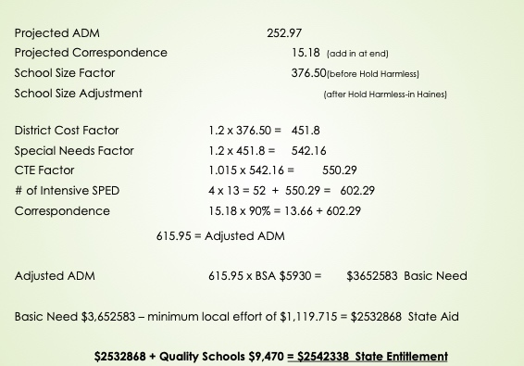
FOUNDATION FORMULA EXAMPLE:

Slide 15
Summary
All budgets are based on projections
Budgets are moving targets and must be revisited
Understanding the terms are key in understanding the Foundation Formula
Boards pass budgets and superintendents manages budgets
The two driving forces in budgeting are enrollments which drives revenues and staffing which drives expenditures
Notes:
I realize that there is a great deal of information here and it may seem a bit into the weeds but hopefully the next time you hear some of these terms and see some of the numbers they will make a little of sense.

Slide 16
Contact Information
If you have questions, please feel free to contact me:
Rich Carlson
rcarlson.aasb.org
463-1681

