Slide 1
CRESEL PLC: Kodiak
WELCOME! Please get settled in and:
Turn on both your audio and video.
Type a greeting into the chat box to let us know who is joining.
Have our shared CRESEL PLC google doc open and ready to use.
In Every Chair a Leader – December 3, 2018

Slide 2
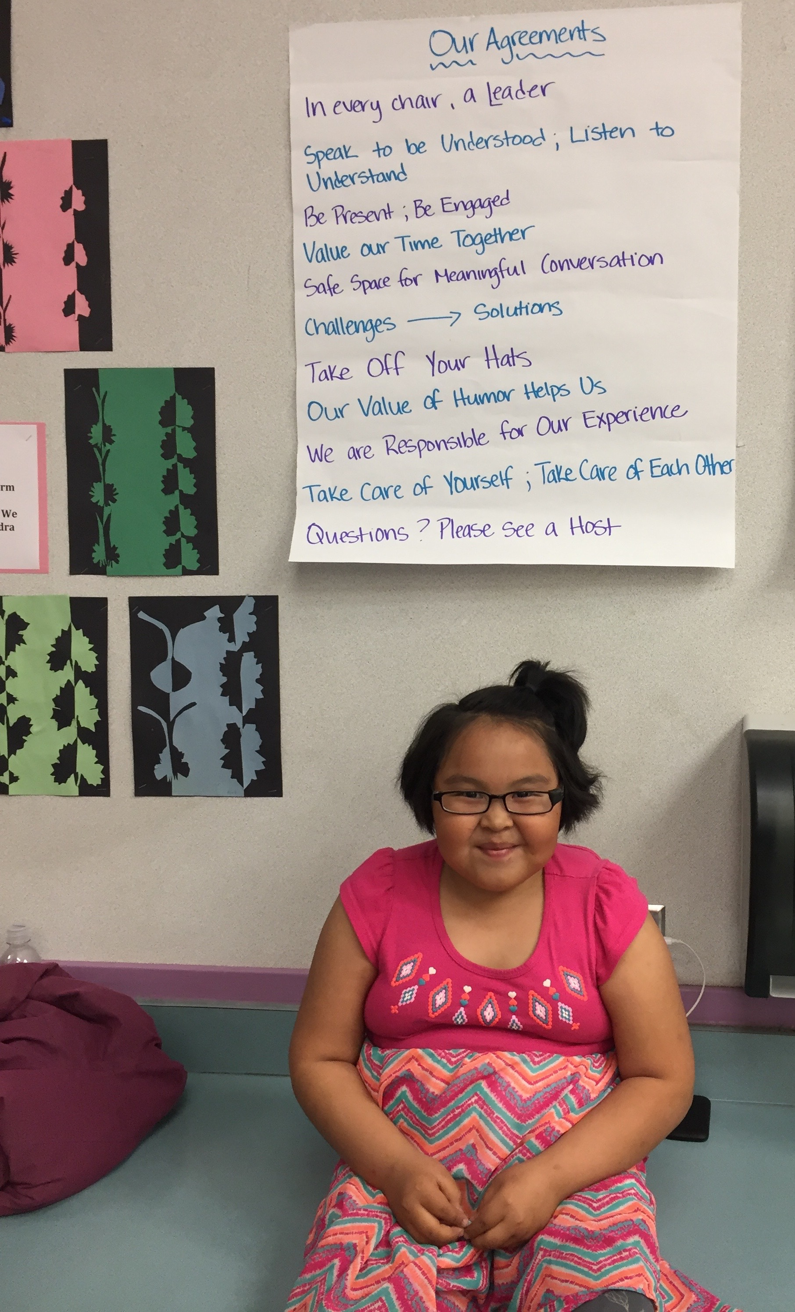
OUR Agreements
Safe space for meaningful conversation
Listen to understand
Speak and write with care for others
Value or time together – Be present, be engaged
Challenges → Solutions

Slide 3
Our protocol
3:30 – 4:30p
Welcome (2 mins)
CRESEL in Kodiak (20 mins) – Kim Hanisch, Kodiak
Clarifying Questions, if needed (5 mins)
Individual Reflection in Google Doc (5 mins)
Collaborative Discussion (25 mins)
Closing Reflection in Chat Box (3 mins)
4:30 - 5:00p
Optional Sharing & Technical Assistance

Slide 4
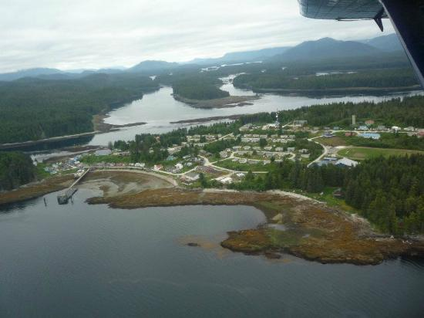

WELCOMe Tanya & Rita!
STEPS Alaska: Supporting Transitions & Educational Promise in Southeast Alaska
Tanya Salmi
Project Manager, Angoon
Rita Crouch
School Counselor, Hoonah

Slide 5
Who’s in the zoom Room?
In the chat box, please write…
Your name
District and community
Something you are grateful for this Thanksgiving season

Slide 6

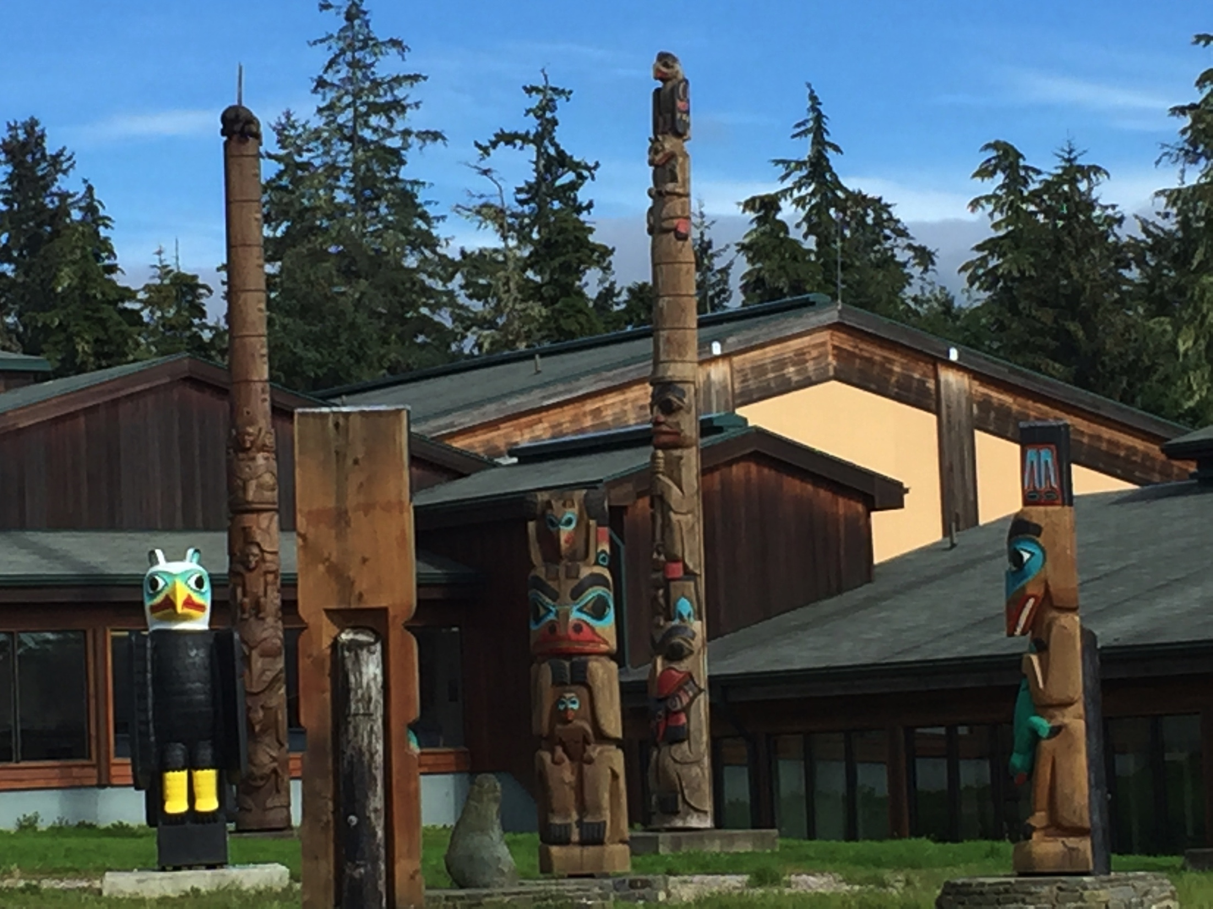
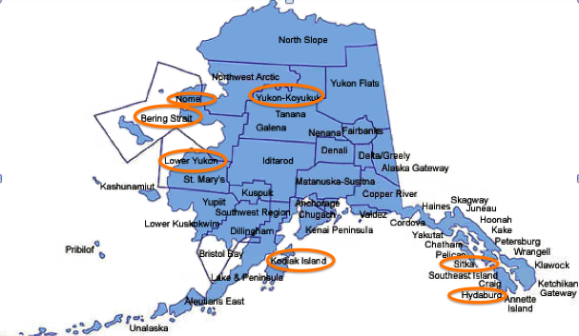
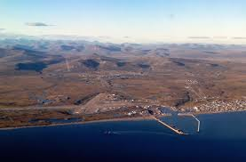
Thank you Hillary, Diana, erin, & Bridie!

Slide 7

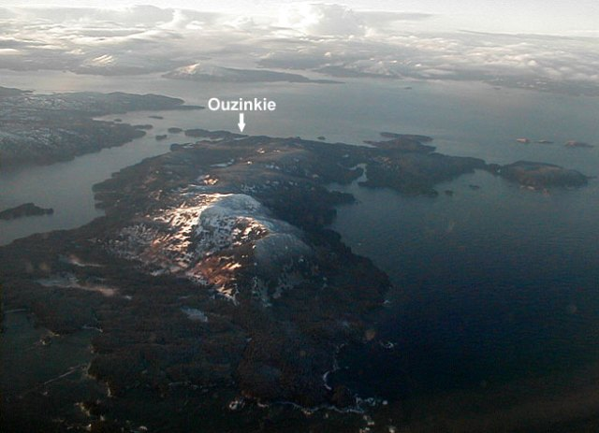

Welcome KIM!

Slide 8
Clarifying questions?
Individual Reflection in Google Doc:
(1) What is your district’s “why” for doing this work (vision, goals, outcomes)?
(2) What can we measure? What are you measuring to track the impact?
(3) What can we and/or AASB do to help administration hear that having a district-wide vision for this work is a crucial part of the process?
(4) What is the change we want to achieve? Is implementation of tools and projects the change we intend or is it bigger than that?
(5) How does a system, or even a classroom, maintain a focus and commitment to plans for long-term changes in the midst of reacting to the day-to-day issues that demand action?
(6) How can we influence system change when we may not be in a position of authority?

Slide 9
What is your district’s “why” for doing this work (vision, goals, outcomes)?
What can we measure? What are you measuring to track the impact?
What can we and/or AASB do to help administration hear that having a district-wide vision for this work is a crucial part of the process?

Slide 10
(4) What is the change we want to achieve? Is implementation of tools and projects the change we intend or is it bigger than that?
(5) How does a system, or even a classroom, maintain a focus and commitment to plans for long-term changes in the midst of reacting to the day-to-day issues that demand action?
(6) How can we influence system change when we may not be in a position of authority?

Slide 11
announcements
Champion Log – survey monkey link
Next PLC is Monday December 10 (back-to-back sessions) at 3:30p

Slide 12
Closing
Please type into the chat box…
A gratitude about today’s session
How will you use what you learned today?
See you next week on Monday Dec 10 @ 3:30 for conversation with Fargo in Yukon Koyukuk!

Slide 13
Host Debriefing Questions
Congratulations on hosting!
How do you feel?
What went well?
What would you do differently next time?
What did you learn?

