Slide 1
CRESEL PLC: Hydaburg
WELCOME! Please get settled in and:
Turn on your audio and video.
Type a greeting into the chat box to let us know who is joining.
Have our shared CRESEL PLC google doc open and ready to use.
In Every Chair a Leader - October 22, 2018

Slide 2
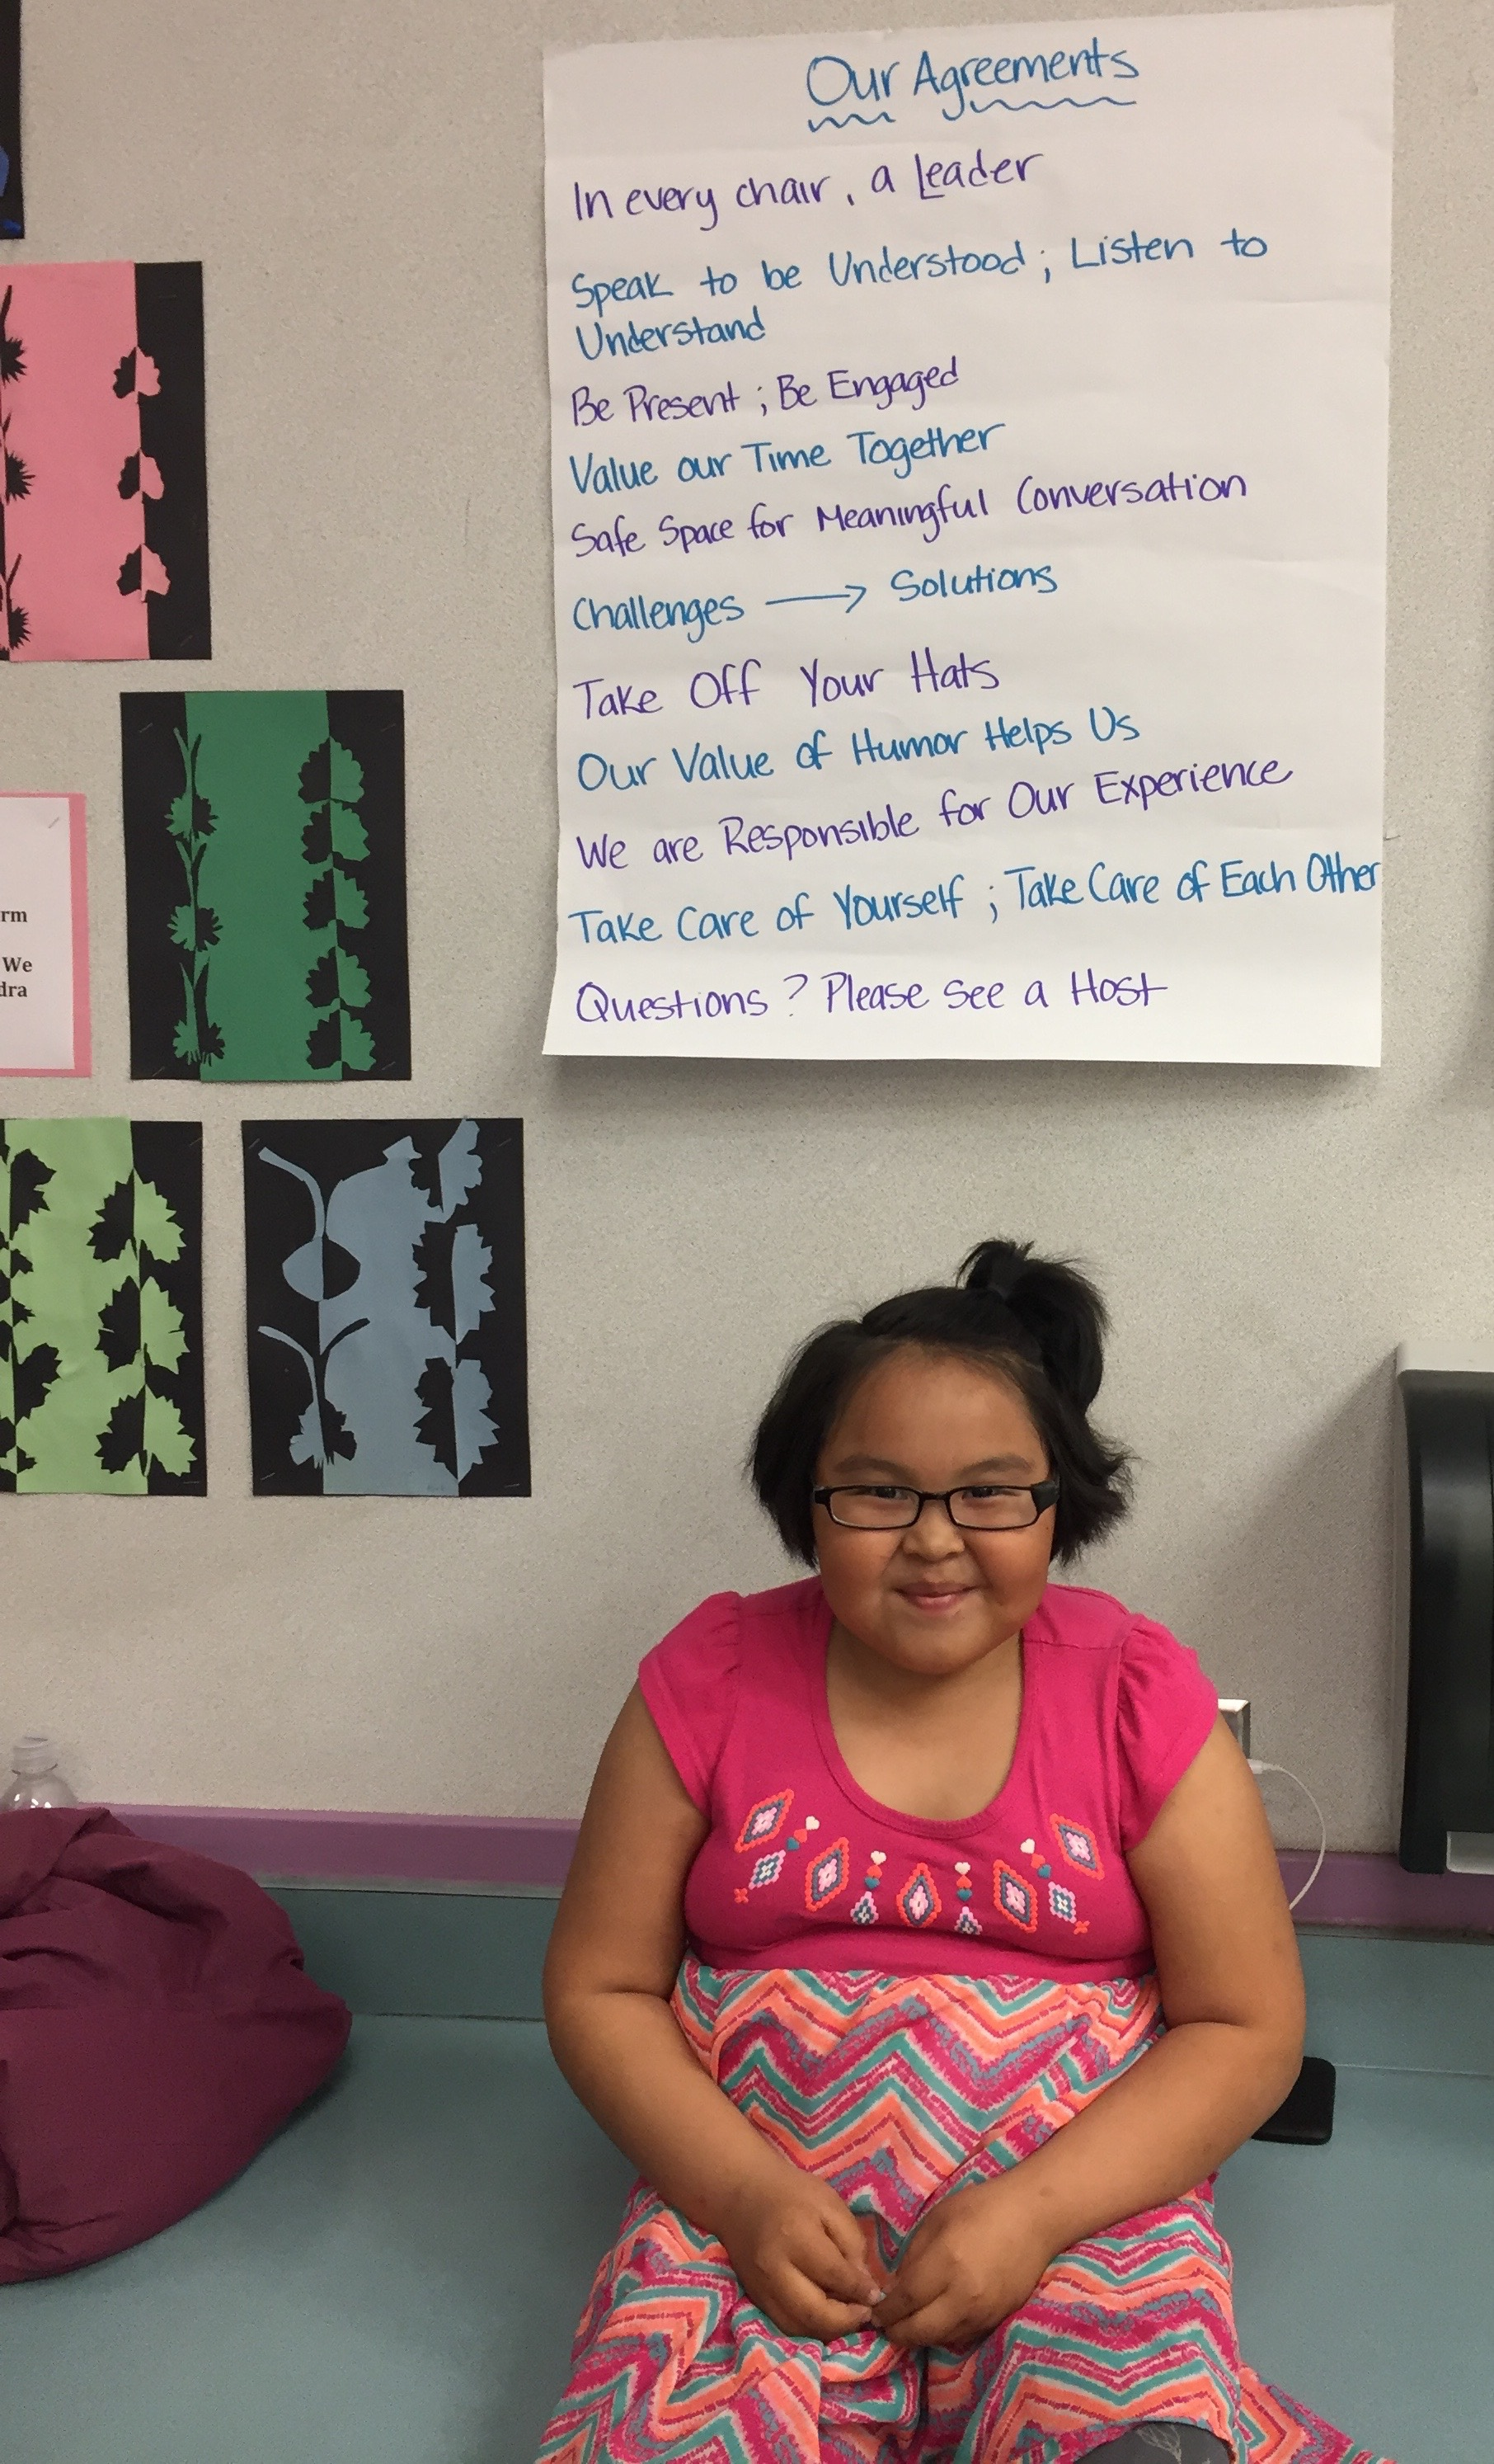
OUR Agreements
Safe space for meaningful conversation
Speak to be understood, Listen to understand
Speak and write with care for others
Value or time together – Be present, be engaged
Challenges → Solutions

Slide 3
Our protocol
3:30 – 4:30p
Welcome (2 mins)
Presentation (20 mins) – Erin Wright, Hydaburg
Clarifying questions, if needed (5 mins)
Individual Reflection in Google Doc (5 mins)
Collaborative Discussion (25 mins) – Erin
Closing Reflection in Chat Box (3 mins)
4:30 - 5:00p
Optional Sharing & Technical Assistance

Slide 4

Hydaburg City School District
Community Conversations and Action Plan
What we are implementing now!
In Process
Reflection
CRESEL Grant – Lights, Action, Camera!

Slide 5
Community Conversations
Hydaburg has had at least 4 Community Conversations with the help of First Alaskans. From these first conversations, information was mined from the conversations from community members as to what role they wanted the school to play. Haida culture, values, and language was something that most community members wanted the school to integrate into the education plan of their children.
Haid Art
Pre K-K Immersion Program
Values integrated into the SEL standards
Creating a more welcoming environment for families and community members into the school
The school becoming a central cultural center for the community.

Slide 6
Action Plan
Dynamic Document
Flexibility
Focus on Needs!
The action plan has become a dynamic document that evolves over time and the changing needs of the students, staff, and community. We use the community conversations, input from community members, staff, and students, and data from surveys and standardized testing to modify the action plan.

Slide 7
What has been placed in action so far!
PBIS – Warrior Buck monetary behavior economy.
Students of the month!
Honor roll
Second Step and/or other SEL programs within classrooms
Part-time counselor
SEL standards
Pre K-K Haida Language Immersion program
School newsletter

Slide 8
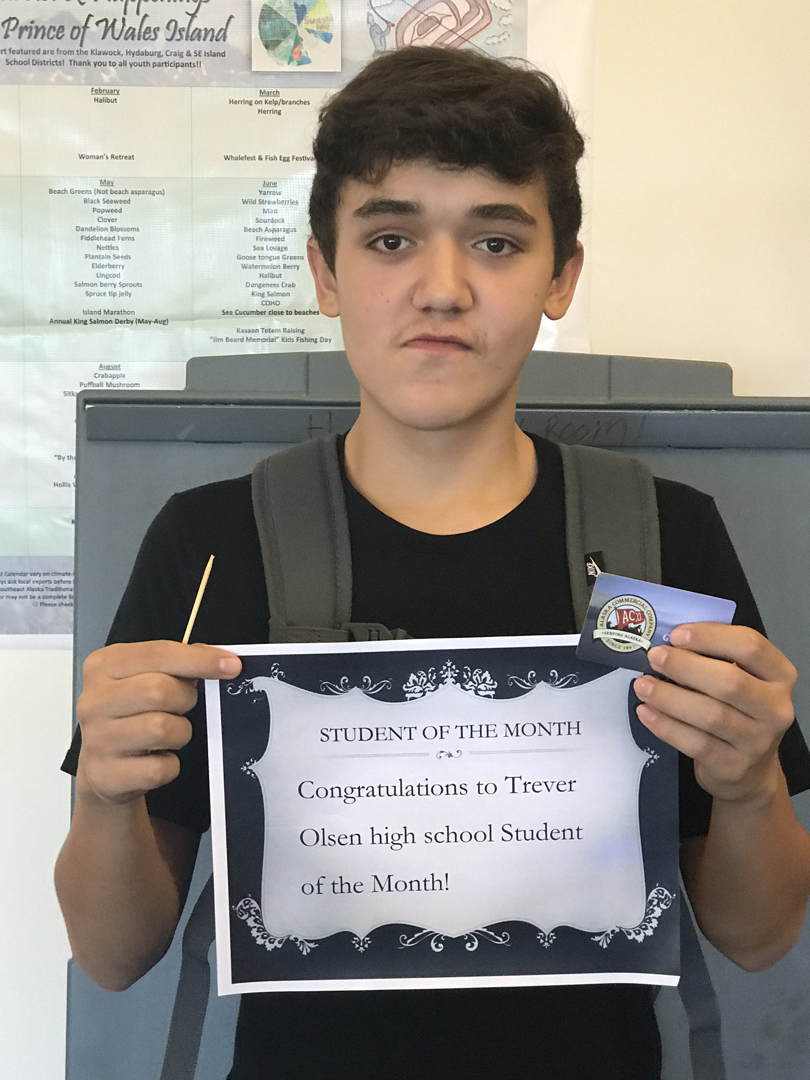
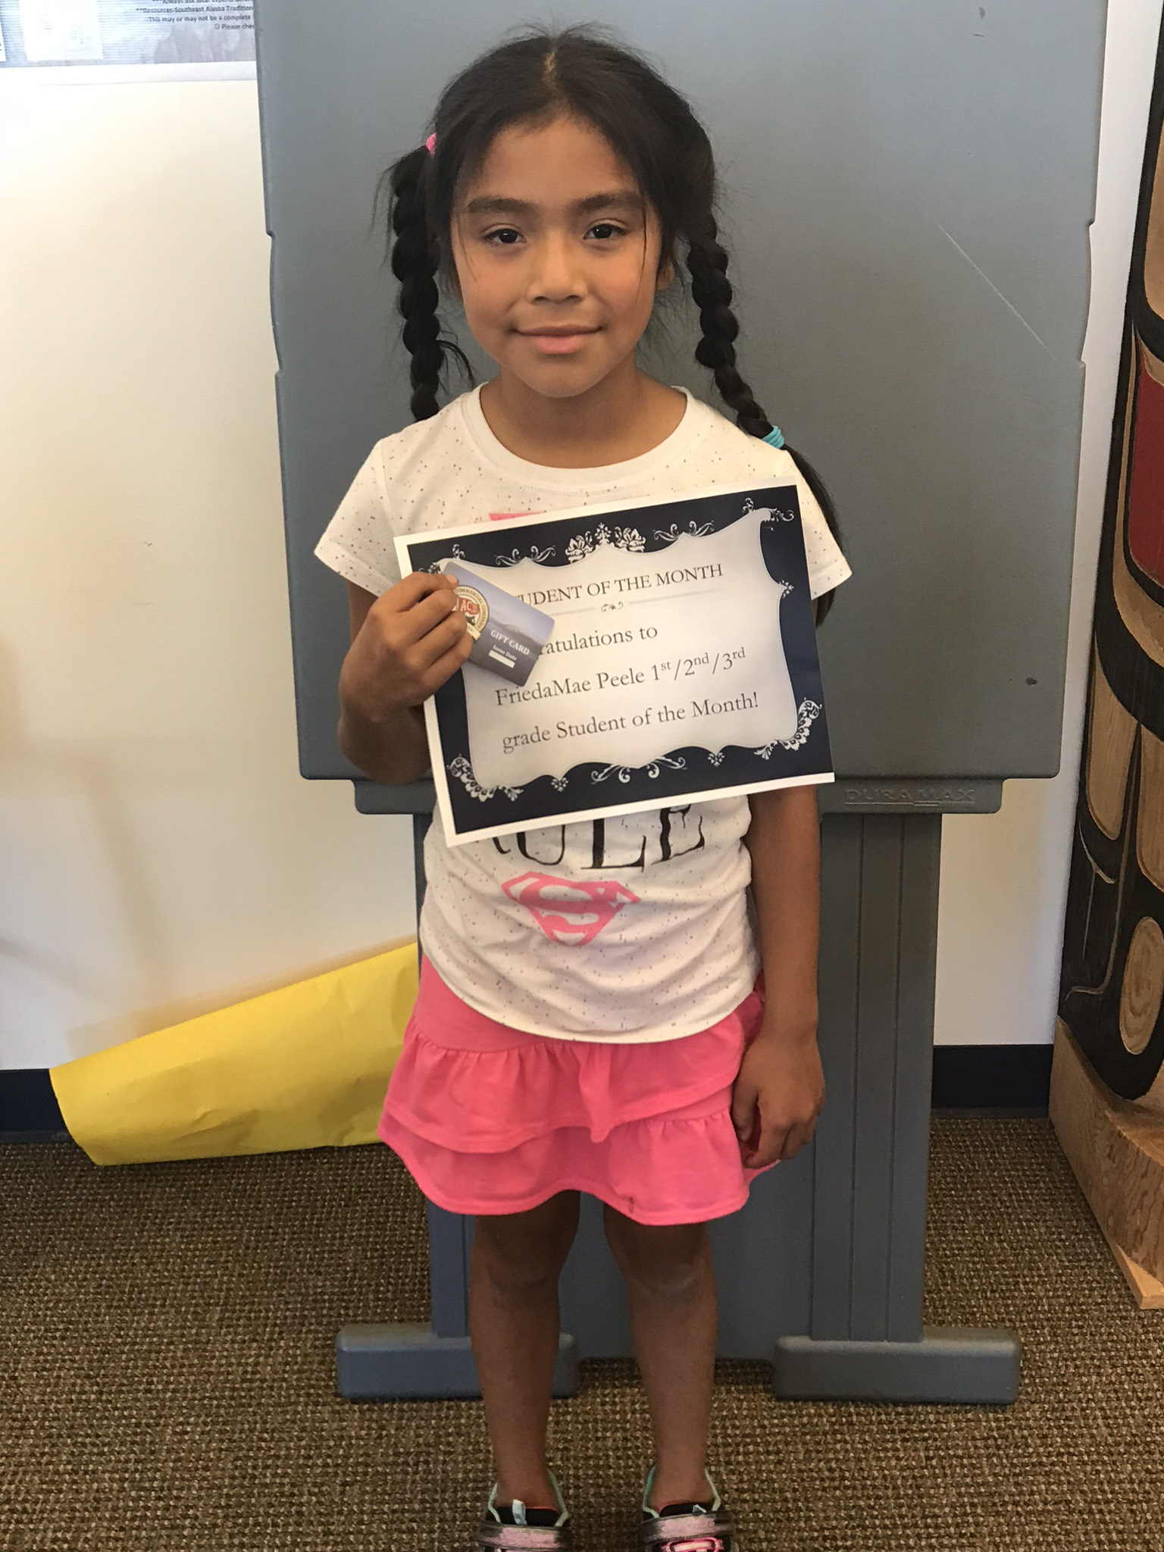
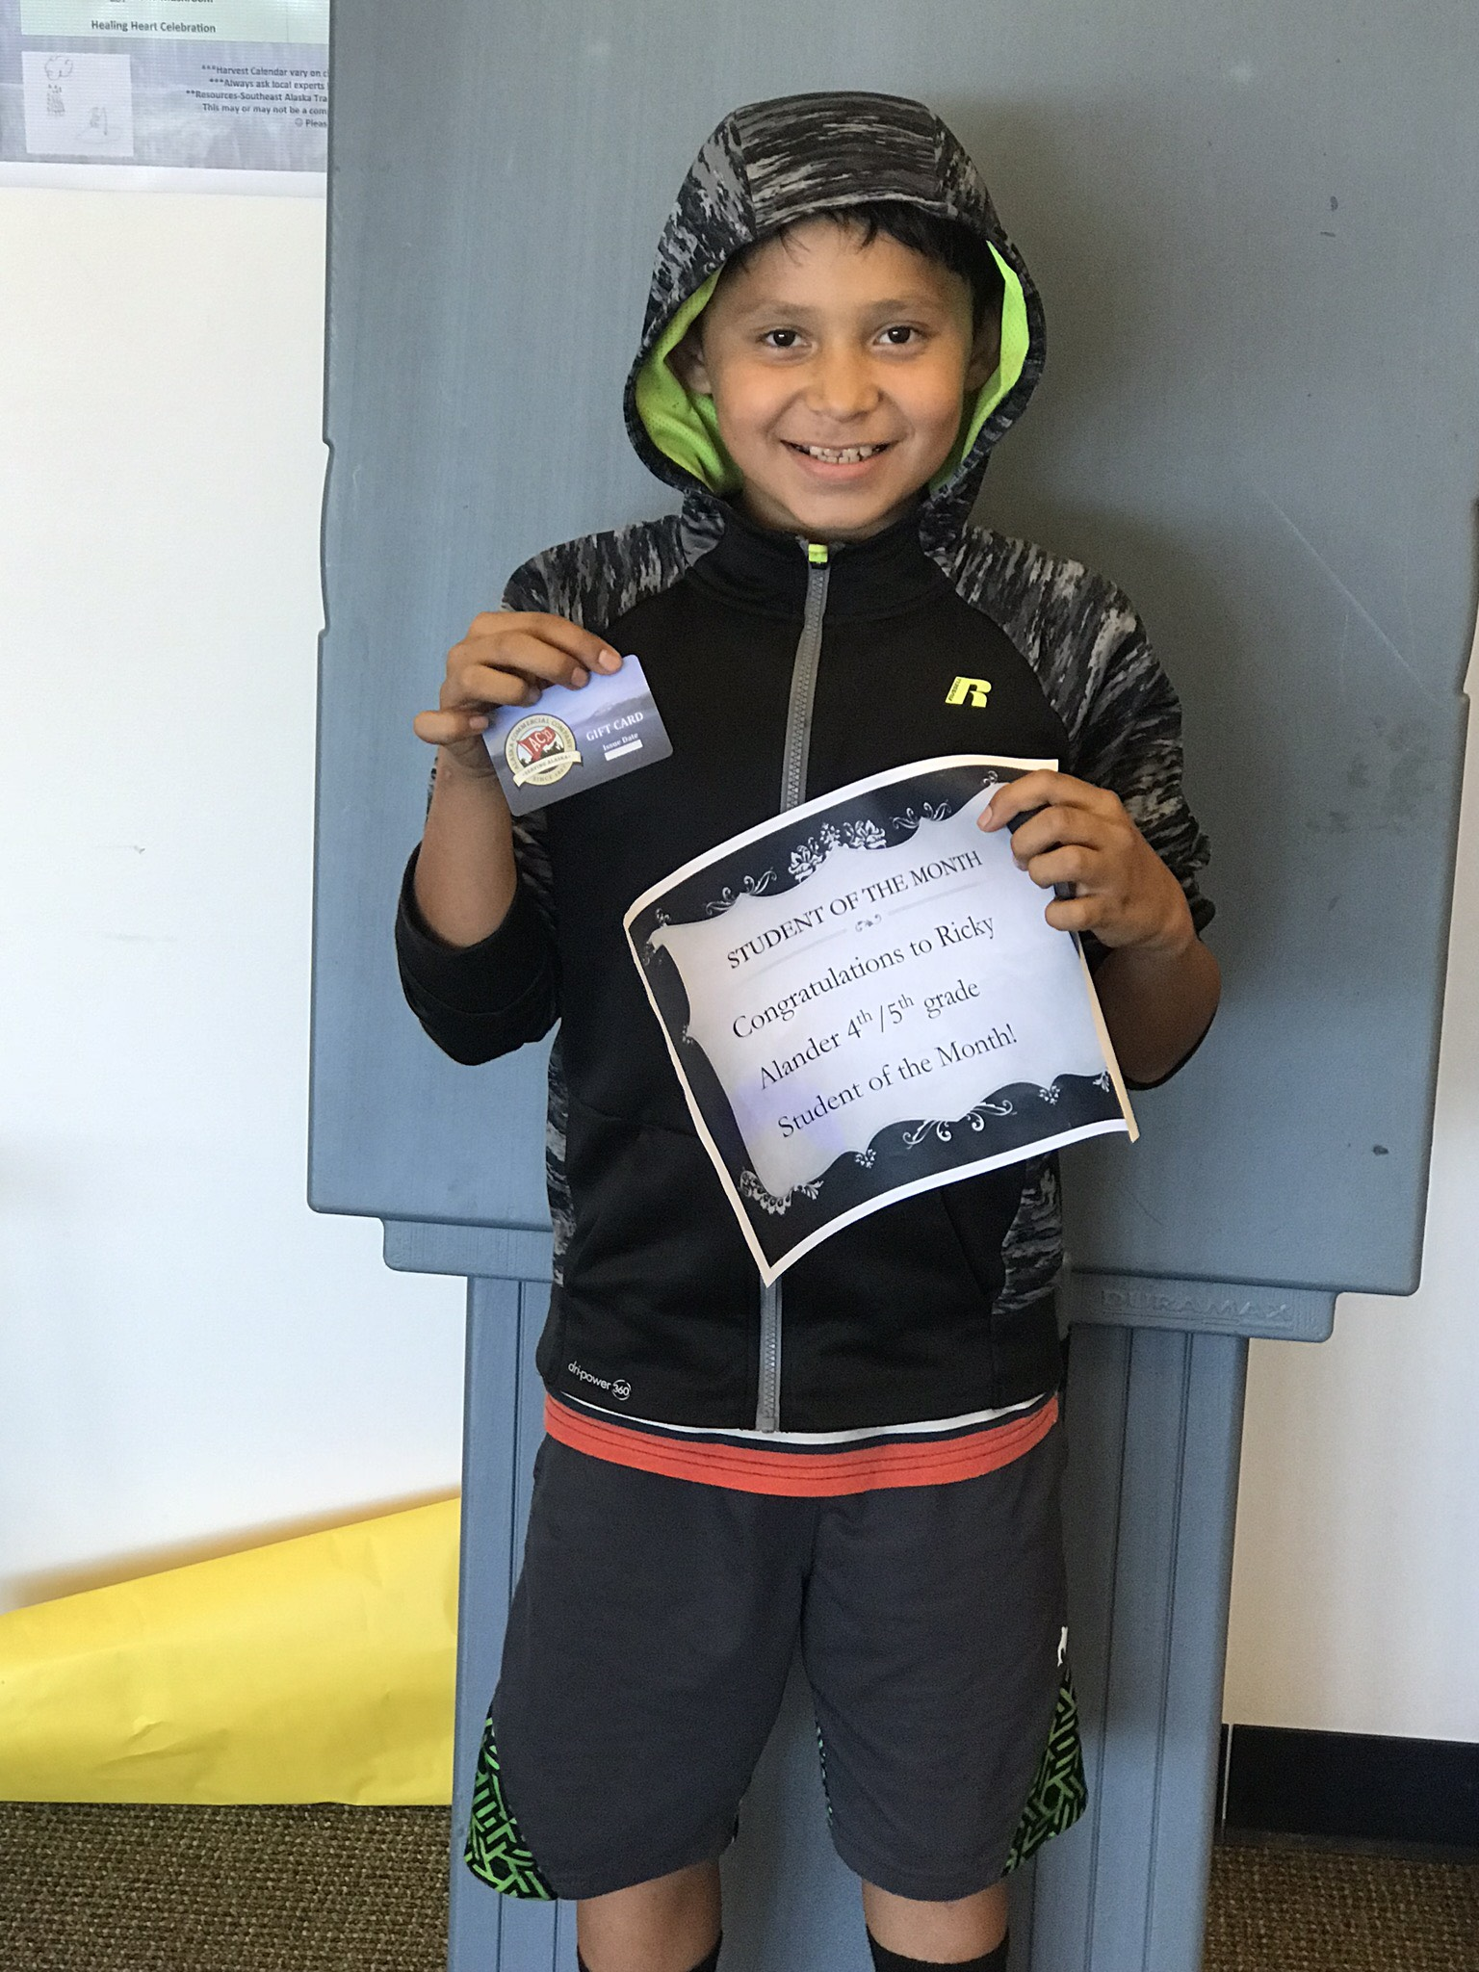
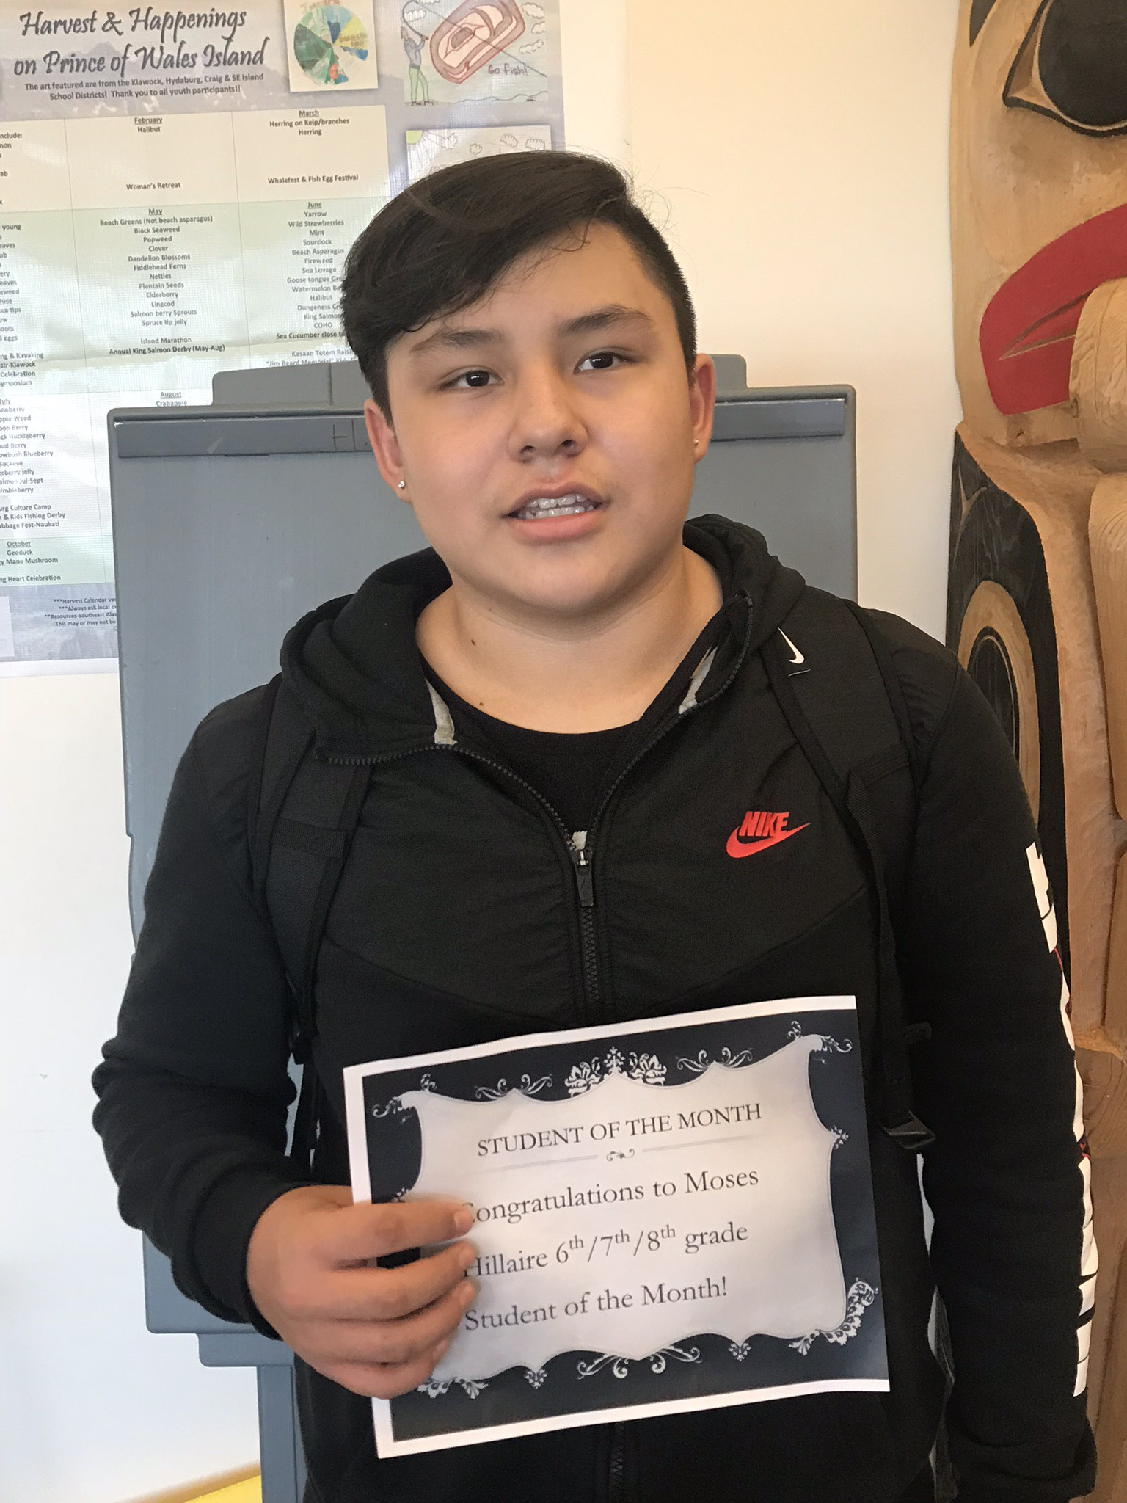
Based on SEL skills
Students of the month!
Students are nominated by staff. A student from each grade group is chosen each month. (1-3) (4-5) (6-8) (9-12)

Slide 9
What we are working on
Parent of the month
Whole school gatherings
Staff self care
Staff gatherings and co- creative collaboration
Another Community Conversation with the topic being. “How to include and welcome grandparents into the school environment”

Slide 10
Reflection
Looking at a deeper more meaningful role that he CRESEL grant can play.
Trauma informed care – training for staff, students, community, and families.
Better buy-in by staff and more training(PLC, the seriousness of suicide crisis, threats and suicide prevention, SEL standards integrated in lesson plans
How to create a more cohesive staff that is part of the creative and collaboration process on every level.
Creating more family and community driven activities within the school and classroom.

Slide 11
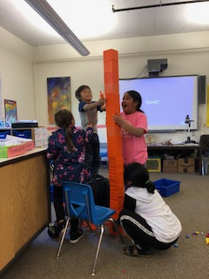
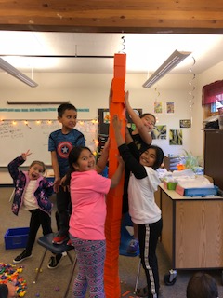
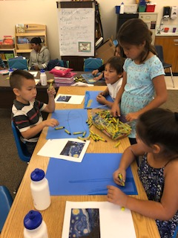
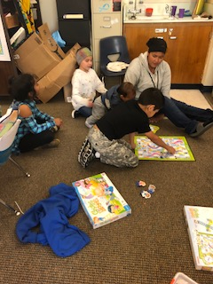
SEL Standards in Action!
Multiple grades working together in planned and spontaneous collaboration!
Self-Awareness – Students understand that school-wide expectations and responsibilities promote a safe and productive environment

Slide 12
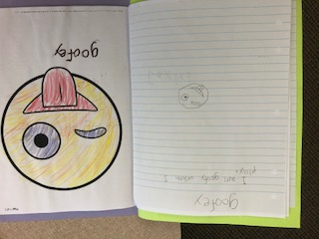
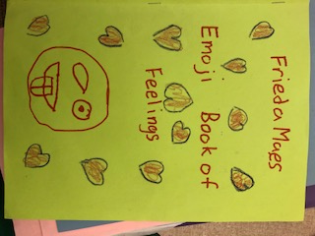
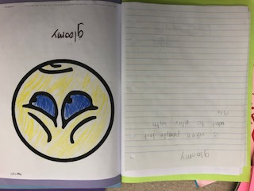
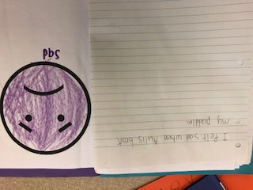
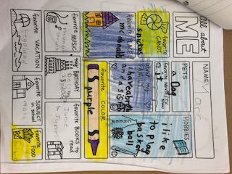
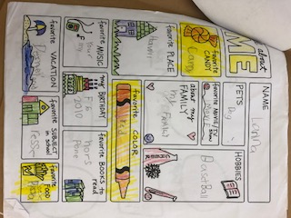
Self-Awareness
Class assignments and projects that focus on SEL skills!
Students recognize and label emotions and feelings
Describe their emotions and the situations that cause them.
Identify their likes and deslikes

Slide 17
Clarifying questions?
5 min for Individual Reflection in Google Doc:
1. What are your thoughts about why it is so difficult to get buy in?
2. How can I include more staff in CRESEL responsibilities when it is not part of their job description?
3. How can I support and create an environment for a staff to be a collaborative team? What are some strategies to bring us together as a team?

Slide 18
1. What are your thoughts about why it is so difficult to get buy in?
2. How can I include more staff in CRESEL responsibilities when it is not part of their job description?
3. How can I support and create an environment for a staff to be a collaborative team? What are some strategies to bring us together as a team?

Slide 19
Closing
CHAMPION LOG REMINDER:
Please click on the Champion Log survey monkey link to record the CRESEL activities in your district and schools this week. Thank you!
Please type into the chat box…
How will you use what you learned today?
See you on Monday Nov @ 3:30 to hear from Bridie in Nome!
Stick around until 5:00 for more sharing and/or technical assistance!

