Slide 1
Can you hear me now? Incorporating stakeholder voice into your state association’s board Development strategy
Trainers Conference- Alaska
June 22,2018

Slide 2
Agenda
Roles and Responsibilities: School Boards vs. Associations
Who are our stakeholders?
Why is stakeholder voice important?
What is the association’s role?
When and where is stakeholder voice appropriate?
How can we help?

Slide 3
Roles & Responsibilities
School Board Associations
School Boards
Provide training, guidance and support
Purpose: To have strong boards and board leaders who are:
  Informed
  Advocates
  Focused on student success
Provide direction, insight, accountability
Purpose: To satisfy public interest of effective school system
  Student achievement (Academics)
  Well-rounded (Social skills)
  Contributing citizens (….and beyond)
Notes:
Assoc.
Are goal is to not only help boards understand what is expected of them ( the nuts and bolts) but to see the influence they have not only in the board room but as advocates for education local, state and federally.
Boards
We want to see them academically challenged and achieving
We want them to know how to get along with others and be exposed to experiences that will engage them and support their development
And we want to have them prepared to be adults in the world whether that is college, work but understanding they play a role in the world around them.
Really, when you talk about good boards and when we talk at NSBA and even at our association we talk about, directly or indirectly, this idea of servant leadership.

Slide 4
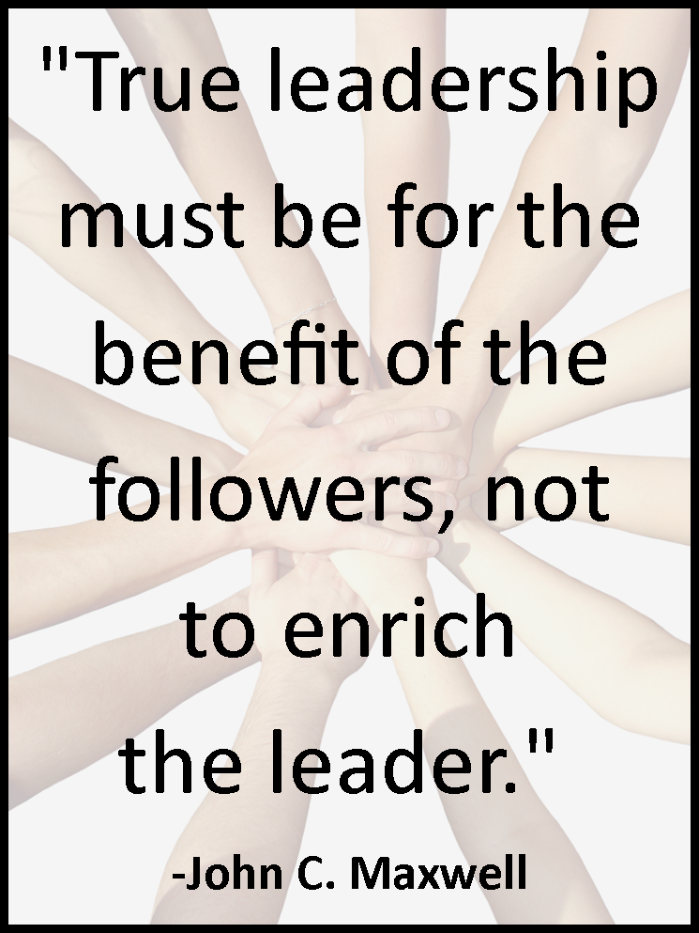
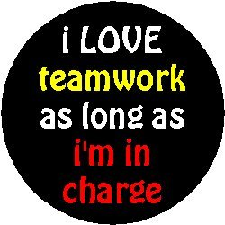
Roles & Responsibilities
Notes:
Often times we may find ourselves battle this idea….everyone want to be the leader, to be in charge to have influence.
I don’t know how many times I have been asked to do a Board roles training or open meeting law training when really the issue was conflict or ineffective boardsmanship which could be tied back to one or more members forgetting what it’s really all about. What I believe we really do as associations is move boards to become better servant leaders- to execute their roles as board members in a way that put students first. This is where I think we can make the most impact as associations. So how do we do that

Slide 5

Roles & Responsibilities
“A servant-leader focuses primarily on the growth and well-being of people and the communities to which they belong. While traditional leadership generally involves the accumulation and exercise of power by one at the “top of the pyramid,” servant leadership is different. The servant-leader shares power, puts the needs of others first and helps people develop and perform as highly as possible”.
- Robert k . Greenleaf Center for Servant Leadership
Notes:
Robert K. Greenleaf, while not the first talk about leaders and public servants, did coin the phrase “Servant leadership in 1970 in his essay The Servant as Leader.
Others have also championed this form of leadership
Ken Blanchard, Stephen Covey (7 Habits), Margaret Wheatley( Walk Out, Walk On) Not drop outs, but walking out to find better. Idea that everyone is capable, not only some care, only some can.

Slide 6
Roles & Responsibilities
“A servant-leader focuses primarily on the growth and well-being of people and the communities to which they belong. While traditional leadership generally involves the accumulation and exercise of power by one at the “top of the pyramid,” servant leadership is different. The servant-leader shares power, puts the needs of others first and helps people develop and perform as highly as possible”.
- Robert k . Greenleaf Center for Servant Leadership
Notes:
If we break this down, becoming servant leaders requires two things: First you must know your community and the people you serve. We’ll talk later about some ways we can help our boards do this better but the focus here is on awareness. How can you serve a community if you do not first understand what their needs, challenges and assets are? This requires asking and listening

Slide 7
Roles & Responsibilities
“A servant-leader focuses primarily on the growth and well-being of people and the communities to which they belong. While traditional leadership generally involves the accumulation and exercise of power by one at the “top of the pyramid,” servant leadership is different. The servant-leader shares power, puts the needs of others first and helps people develop and perform as highly as possible”.
- Robert k . Greenleaf Center for Servant Leadership
Notes:
This second part is a bit harder. You have to engage your community. But not passive engagement… active engagement.
Shares power- gives them voice, influence over decisions
Put the needs of others first- Not concerned with how allowing for voice will impact you station, your agenda, make things awkward or more difficult for you. We make a concerted effort to know the needs of people and not infer what we think they are based on our feelings or experience.
Helps people develop- There is empowerment built in there, not elite advocacy where we say of we know what you need….but authentic advocacy where you empower them to advocate and collaborate to find shared solutions.
Listening and active engagement are key components to servant leadership.

Slide 8
Identifying Stakeholders
Stakeholder: Individuals or groups who are directly impacted by the decisions made and products of an entity
Brainstorm 1: Who are our stakeholders?
  Associations
  School Board
Notes:
If our job is to help boards do their job, then we should know understand who their stakeholders are too. Ultimately we are all serving students and communities. And, while we can certainly tell them what they have to do in terms of policy budgets, superintendents relations or how to behave ethically and how to get along-- if they or we do this in a bubble with out bringing in those that are most impacted (students, families, teachers, staff), I argue, we are doing or boards a dis-service.
What are the concerns of stakeholders?
We’ll come back to this…..

Slide 9
Identifying Stakeholders
Stakeholder: Individuals or groups who are directly impacted by the decisions made and products of an entity
Brainstorm 2: What are their concerns? Interests?
Notes:
If our job is to help boards do their job, then we should know understand who their stakeholders are too. Ultimately we are all serving students and communities. And, while we can certainly tell them what they have to do in terms of policy budgets, superintendents relations or how to behave ethically and how to get along-- if they or we do this in a bubble with out bringing in those that are most impacted (students, families, teachers, staff), I argue, we are doing or boards a dis-service.
What are the concerns of stakeholders?
We’ll come back to this…..

Slide 10
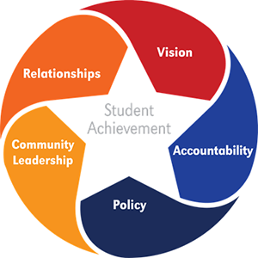
The Key Works of School Boards
From NSBA’s Key Works of School Boards, 2015
Notes:
Looking at NSBA’s Key Works of school boards, each area significantly impacts stakeholders. Attempting to do the work of school boards, without input from those we are serving is not servant leadership.
Each of you are doing training in each of these areas and in each on of the areas trainers need to be asking boards how stakeholder engagement applies.

Slide 11
Why Stakeholders Voice is Important
Relational
  How can you provide good service and keep “customers” if you are not attune to their concerns?
Logical, promotes:
  Trust
  Support
  Collaboration
  Outcomes
Notes:
Here I am going to speak to different types of members. First the relational ones- How can you represent if there is not relationship?
Second for our analytic;
Start with the moral argument, move to the logical argument and them move to the hammer.
Trust, as mentioned before more focus is being place on what schools are doing with their budgets, with achievement with equity. It is going to become more and more necessarily to share information with the community
Support, As public schools come under increased scrutiny, especially in states like Arizona, Florida and other that are being impacted by growing charts schools and decrease funding, we will need public support of public schools.
Collaboration, People are more likely to support and trust a systems if they have ownership in it. Collaboration helps folks feel more connected.
Outcomes, from the light house students and other subsequent studies we know boards that are effective see better outcomes If you look at the center of public education Eight characteristic of school boards you’ll see that 4 speak specifically to the need for collaborative relationships with stakeholders. But they also talk about knowing the community you serve

Slide 12
Why Stakeholders Voice is Important
Practical-It’s the law
  Every Student Succeeds Act (ESSA)
    Carry over of NCLB: Districts must
      Offer programs and activities and seek “meaningful consultation with parents”
      Develop written policy (for Title 1 schools)
      Build capacity to support families in engage school system
    New in ESSA
      In its policy- establish expectations and objectives
      Must do at least 1 prescribed engagement strategies: PD for staff, home-based programs, information dissemination, collaboration with community orgs)
Notes:
Finally for our traditional or policy or black and white thinkers.
Some members might feel that, because they were elected, the represent a constituency . That by simply making decisions they way they see fit, they are representing the portion of the public that thinks like them. However, once on the board, a members duty is to do what is best for all students. If, for the sake of argument, our associations were completely compliance based- the requirements of ESSA should be something we are supporting boards with. Aside from Parent engagement, there are various reporting requirements that are going to begin to push information out into the light in a way that will likely result in more conversations about what districts are doing to meet the needs of students.

Slide 13
What’s the Association’s Role?
Provide services that support boards in effective governance
Including stakeholder voice allows associations to:
  Provide a service for an unmet need
  Increase facilitation based service
  Promote equity
Notes:
If our job is to help boards do their job, then we should know understand who their stakeholders are too. Ultimately we are all serving students and communities. And, while we can certainly tell them what they have to do in terms of policy budgets, superintendents relations or how to behave ethically and how to get along-- if they or we do this in a bubble with out bringing in those that are most impacted (students, families, teachers, staff), I argue, we are doing or boards a dis-service.
And they want it
Boards and districts all seem to want to increase engagement and incorporate stakeholders. Not all have the internal resources to do so
Providing facilitations around topics of need for district that are beyond the basics is a value add. Beyond what they can get at an event…next level.
Stakeholder voice , done well, can begin to introduce equity concepts to districts that are unsure if equity id relevant to them or is scared to “go there”
This allows you to go there to with a community push. Part of the key works is community leadership. You can que up the conversation on your terms or have it reactively on other terms.

Slide 14
What’s the Association’s Role?
To better serve boards, associations need to:
  Understand their stakeholders’ stakeholders
  Model and provide support on how to incorporate stakeholder voice
Notes:
We have to look beyond our immediate customers. It’s a mind shift that our roles as associations is to improve education thorough the promotion of effective and informed boards.
When you go out to do training or facilitation…what do you do to better understand who their stakeholders are?
Before a training/ facilitation…I call all board members and ask them two question. What do I need to know what do you want to get out.
This helps me better meet the needs of the board. The same can be said of asking that of students. Families etc.

Slide 15
Incorporating Stakeholder Voice
Suggestions….
Vision & Goal Setting
Policy
Budget
Academics
Climate & Culture
Activity: Where might we incorporate stakeholder voice?
Notes:
Looking back at our stakeholder list
How could we incorporate Students, parents, staff, community into the following suggestions
Break into groups:
Take students and think your way through
Take Families
Etc.

Slide 16
Incorporating Stakeholder Voice
When
  Before (Brainstorming)
  During (Pulse Check)
  After (Feedback)
  All of the above (Special projects or initiatives)
Notes:
Deciding on when to impropriate stakeholder voice will depend largely on how much wiggle room you are willing/ able to give.
So for board how you can help them do this For example; When looking at policy which tends to be legal, you may not want stakeholder voice at the beginning in developing policy because their may not be room. Youi may instead want to do it as a pulse check or feedback so that you can see, concerns and address them and or connect them with a process around the regulation where there is more flexibility.
Make this example slide
As an association, we had a decision to create and equity committee. When did not ask all members it came from board but after, we can inform of what were doing and get feedback doing or after the process.
Equity Dialogues, where we asked stakeholder directly (external) what they felt boards need to know to serve their communities better
However, if you are helping a district facilitate a community conversation around the type of superintendent that is needed or a communication/ media plan to attract families to the district…you may want to have several session where stakeholders are brought together.

Slide 17
Incorporating Stakeholder Voice
Before you begin
  Who do you serve?
    Demographics of the state/ community
    Who’s at the table? Who is not?
      “Nothing about us without us”- Ty
Notes:
Is there a feeling of inclusion? Are they able to receive information
Are their poverty or cultural barriers?
Do we as associations and or districts have fear about “opening up”

Slide 18
Incorporating Stakeholder Voice
Before you begin
  Identify Barriers
    What might be keeping folks away
      Cultural barriers (Race, Geographic, Rural/ Urban etc.)
      Inclusion/ acceptance/ receptivity(Safe/ welcoming space)
      Information( Can I receive it? Understand it?)
      Authenticity( Do my behaviors match my words)
    What fears might be keeping us closed
      Fear of being wrong
      Fear of being challenged
      Fear of discomfort
Notes:
Is there a feeling of inclusion? Are they able to receive information
Are their poverty or cultural barriers?
Do we as associations and or districts have fear about “opening up”

Slide 19
Incorporating Stakeholder Voice
Before you begin
  Identify champions
    Individuals
      Parent, staff, students who can bring other along “vouch”
    Trusted community leaders
      Churches, advocate groups, diverse education leaders universities, student groups
Notes:
These are all conversation we can facilitate to help districts set assess and build foundation for stakeholder voice
Did a different well and look outside the box.

Slide 20
Incorporating Stakeholder Voice
Choose your tool carefully
  Surveys
    Pros
      Quick & Easy (sort of)
      Quantity
      Less coordination
    Cons
      Highly public
      Quality of information
      Response rate varies
Notes:
Survey can be a quick and easy way to get mass feedback fast. But they can also be a fast pass to resentment or a waste of time.
Creating a survey that is short and specific is a good pulse check but if you are using a survey to truly gain insights you will want to look at a tools that are evidence based or well thought out. If you have that capacity at your association this is a tool you can market.
But once it goes out, there is communication that is need and be careful what you ask for and be prepared for what comes up people will expect you to respond.…AJ example
Association- What are people asking for. What is missing. Take feedback from the years events, add suggestions test theories.

Slide 21
Incorporating Stakeholder Voice
How- Choose your tool carefully
  Focus groups/ Committees
    Pros
      Real time Q & A
      More insights
      some coordination
      True buy-in
    Cons
      Get off track
      Lack of representation
      High expectations
Notes:
Focus group. One time input
Committee on going collaborations
Get a richness of feedback and can potential grow strong advocate's and supporters but you have to keep it….focused and be sure that there are the right mix of people in the rooms
If not, re tool and start over…no point trying to move forward with the wrong people of the bus
Take longer and get the stakeholder voice then do it quickie and not get the real voce…clean up later.
Manage expectations and limitations
WESD and Equity Committee
Offered facilitation or create framework for everything for before, during after.

Slide 22
What Associations Can Do
Remember, association members are owners and customers
Ask, how can boards better serve communities
Utilize internal resources- find new products
Build partnership and collect resources
Promote content that demonstrate successful use of stakeholder voice
Notes:
Communication audit
Branding and outreach support
Survey development and monitoring
Growing facilitation services
Framework and tools- Consultation
Partner with community organizations business

Slide 23
Questions?

