Slide 1

\
THE road to racial equity:
Designing Race & Equity Policies
Presenters: Mary Fertakis, M.Ed., NSBA
Colleen Miller, EBD, Washington State School Directors’ Association
Trainer’s Conference, Juneau, Alaska Saturday, June 21, 2018
Notes:
Introduction

Slide 2

Learner Outcomes:
Receive personal, practical, and tactical steps for implementation.
Enhance and expand your equity lens.

Slide 3
Our Norms for this Conversation
(Adapted from Courageous Conversations About Race by Glenn Singleton)
Speak Your Truth
Stay Engaged
Expect to Experience Discomfort at Some Level
Be Aware of Intent; Own Your Impact
Accept and Expect Non-Closure
Maintain a Learner Stance and Remain Open to New Thinking
Notes:
Unpack these:

Slide 4
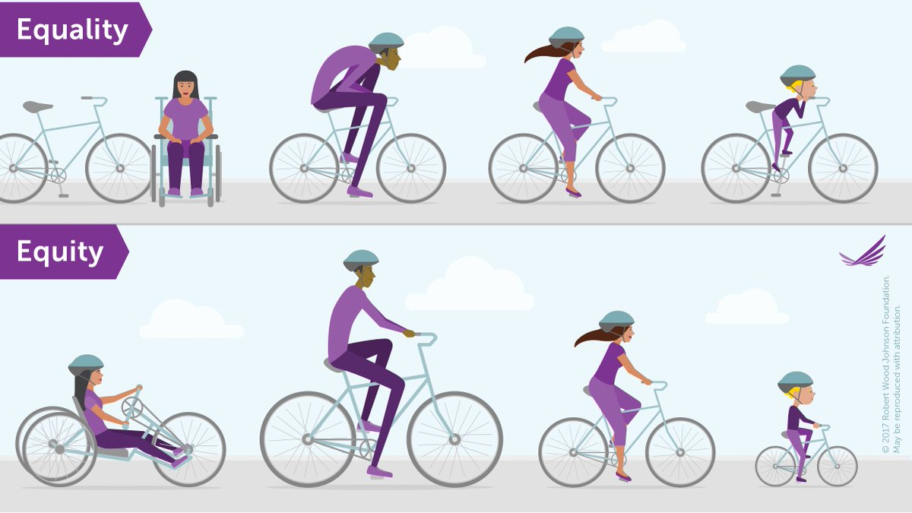
Equality vs. Equity
(Graphic by Robert Wood Johnson Foundation)

Slide 5

WHAT DOES IT TAKE?
Leadership Components:
  Personal/Board Courage
  Personal/Board Commitment
Technical Components:
  Policy Development
  Resource Allocation
Notes:
Leadership Components: Mary
Technical Components: Colleen
Superintendents at risk, board directors at risk when taking on racial equity policy and procedure

Slide 6

TRUST
Capacity to serve in the relationship
Integrity
Benevolent Intent
Notes:
Governance Team of Six: Board-Superintendent
Choose to build trust
Colleen

Slide 7

Speak Your Truth
Everyone has a lived experience; everyone has a personal story.
All perspectives are valid; all perspectives are partial.
(Dr. Marion Smith)
Notes:
Mary

Slide 8
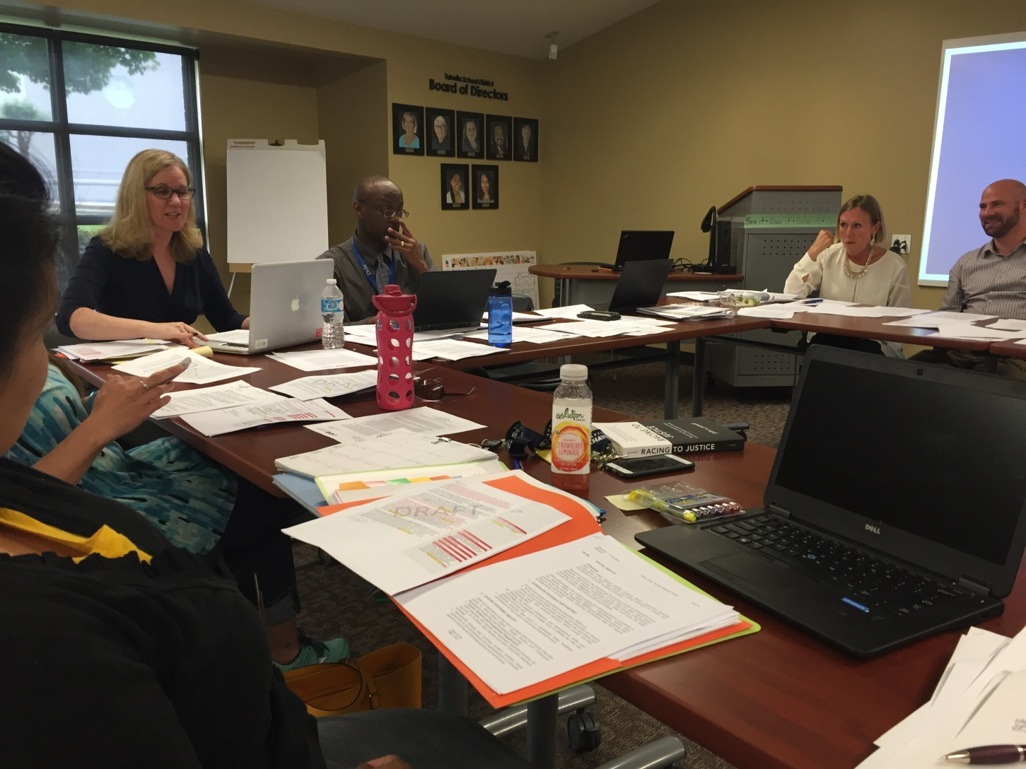
Commitment
Notes:
This is a long road to travel
Developing policy, engaging with your community, Develop procedure and enact the policy from the boardroom to the classroom

Slide 9

Courage
Notes:
Why courage?
What can you expect?
Pushback
Discomfort
Anger
Racism
Not re-elected or pushed out

Slide 10
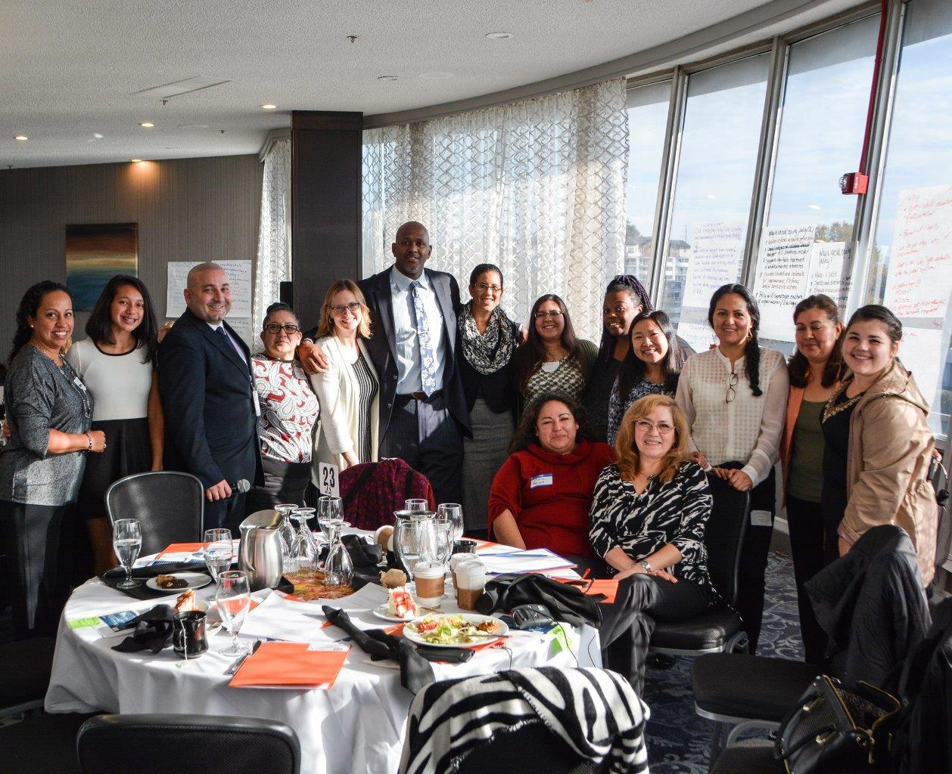
Engage the Willing
Notes:
Engage those who are ready to engage in this work and build momentum that will pull others into the work.
Build critical mass!

Slide 11
Turn & Talk
What are your thoughts about what you have heard so far?
What are the barriers your board members would need to overcome in their local setting to engage in this process?
Notes:
Person of color talks/White person is silent

Slide 12
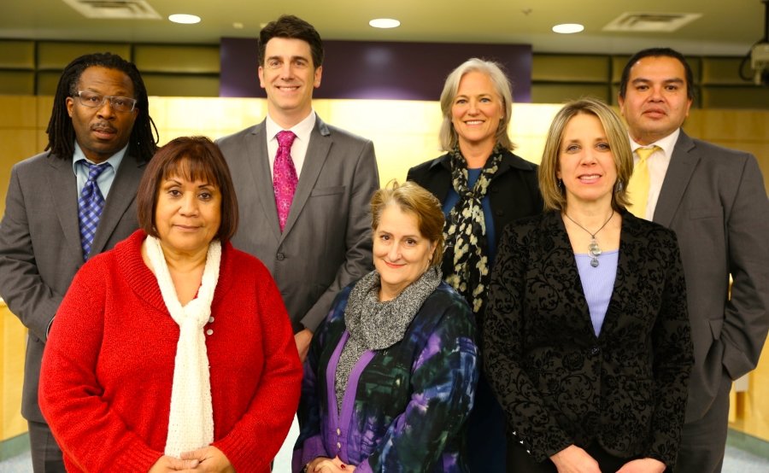
What Does the Leadership Team
Need to Do?
Notes:
Introduce the concept the Governance Team and Reciprocal Accountability
Colleen

Slide 13

Establish the “WHY”
Look at Data
What Stories Emerge?

Slide 14
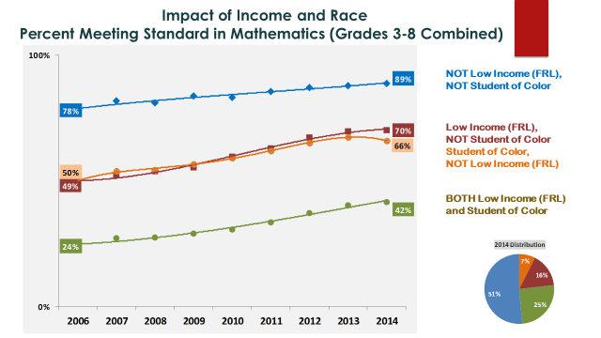
Take a Look - What do you See?

Slide 15
Where to Look for Disparities?
Special Education
Discipline
Access to rigorous coursework
Attendance
Graduation
Course Failures in 9th Grade

Slide 16

YOU MUST:
Have high expectations for all students and staff
Hold them accountable
Provide the support they need to reach those expectations
Notes:
* Soft Bigotry of Low Expectations
* “People were so busy saving me that they didn’t see me” = Dr. Karen Collins, TSU

Slide 17

Develop a Shared Understanding of Racial Equity
What is the school district’s definition of Equity?
Without this definition, the work will stall as everyone has their own understanding or opinion of Equity.
Notes:
Develop a common/shared vocabulary and language
What is the district’s/ organization’s definition of equity???? Must establish this first
* White privilege is always in the room
* Oppression

Slide 18
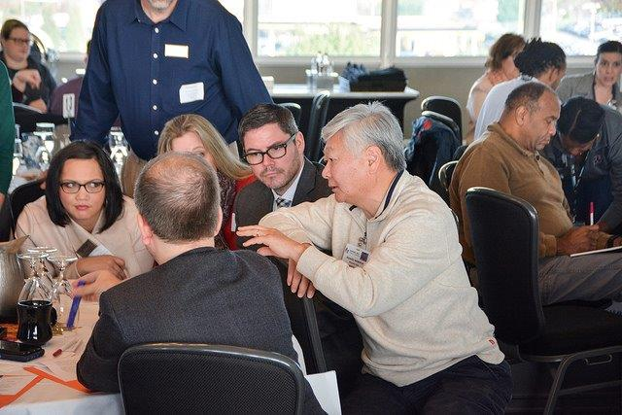
LISTEN to Your Students & Families
Give historically marginalized
students and their families a
voice.
  Make space at the table.
Establish respectful,
authentic partnerships
with families.

Slide 19
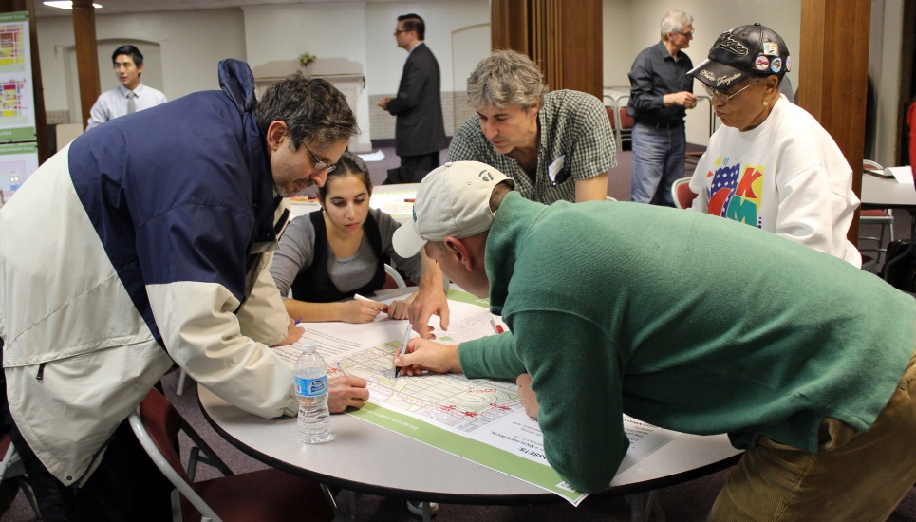
Who Else Do You Engage With?
Internal and external stakeholders
Intentional efforts to reach out to ensure under-represented voices are heard
Student Voice

Slide 20

Authentic Student Engagement
Study Sessions
District Race & Equity Committee
Final product and procedures
Student Race and Equity Club
Ensure their voice makes a difference – not just window dressing.

Slide 21

Are You Personally Prepared for this Work?

Slide 22

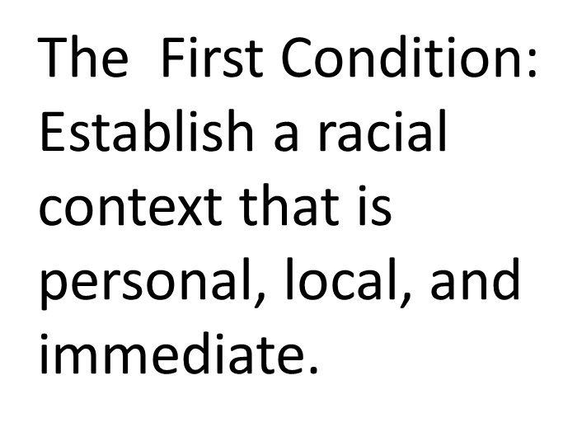
Courageous Conversations About Race
Notes:
* Racial Autobiography
Reflection Journals
Caucus, share your experiences
Tools to use to begin this work

Slide 23
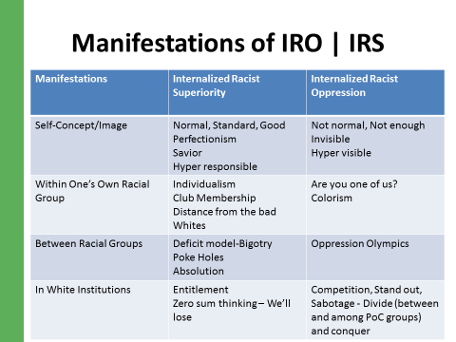
Notes:
Handout?
We cannot speak to a story that is not ours
Important for consideration in our self growth , what this means to us

Slide 24
Resources
Diversity, Equity and Inclusion (Caprice Hollins and Ilsa Govan)
Courageous Conversations (Glenn Singleton)
Race Matters (Cornel West)
Whistling Vivaldi (Claude Steele)
Despite the Best Intentions: How Racial Inequality Thrives in Good Schools (A. Lewis & J. Diamond)
The New Jim Crow: Mass Incarceration in the Age of Colorblindness (Michelle Alexander)
Other People's Children (Lisa Delpit)
Critical Race Theory (Richard Delgado & Jean Stefancic)
White Privilege: Unpacking the Invisible Knapsack (Peggy Macintosh) http://www.cirtl.net/files/PartI_CreatingAwareness_WhitePrivilegeUnpackingtheInvisibleKnapsack.pdf

Slide 25

How Does the Leadership Team Ensure the Policy is Implemented?

Slide 26

Reflection
Making Meaning
  Key Ideas
  Implications
  Questions/Issues
Next Steps
  Who?
  Does What?
  By When?

Slide 27


Enacting Racial Equity Policy
Formally adopt policy.
Develop procedures.
Incorporate with your strategic plan.
Allocate resources to implement procedures.
Develop a plan and schedule to monitor progress of implementation.
Communicate to stakeholders - very clearly – that this is a big deal!
Be prepared for pushback.
Be tenacious, go the distance!
Notes:
Handouts
Always revising, growing and learning
As an indicator of doing the work
Tukwila Policy
Kent Policy
Auburn Policy

Slide 28
Tools for Implementation Work:
A Road Map with eight Action Steps for developing your race and equity policy.
An Equity Tool (created by Portland (OR) Public Schools): A bookmark with five, guiding questions that add an equity lens to your policy, procedures, programs, and initiatives review process.
An Equity Rubric (created by the Tukwila School District Race & Equity Committee): A policy, procedures, programs, and Initiatives tool that will help the Board, Leadership Team, and staff embed an equity lens in their work.
Notes:
Problematic policies
Attendance Model Policy

Slide 29
Can You Do this Work in Partnership with Others?
PSESD
Race to The Top districts
Staff
WSSDA
Design Team

Slide 30
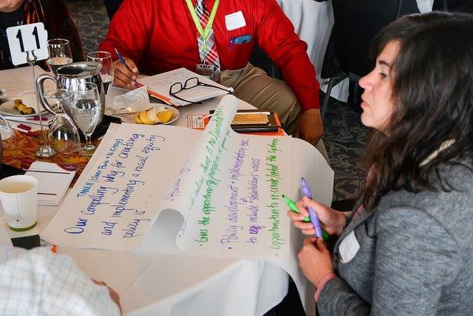
Racial Equity Policy Convenings
* Puget Sound Educational Service District (PSESD)
* Washington State School Director’s Association (WSSDA)
Six Racial Equity Convenings (2015-18):
785 Individuals attended
31 School Districts represented
97 Non-Profits, universities, cities, parents, government agencies, charter authorizers
Planning for the next Convening

Slide 31






This Work Is Never Finished

Slide 32
Questions?

Slide 33

We can do this!
Thank you for attending this session.

