Slide 1
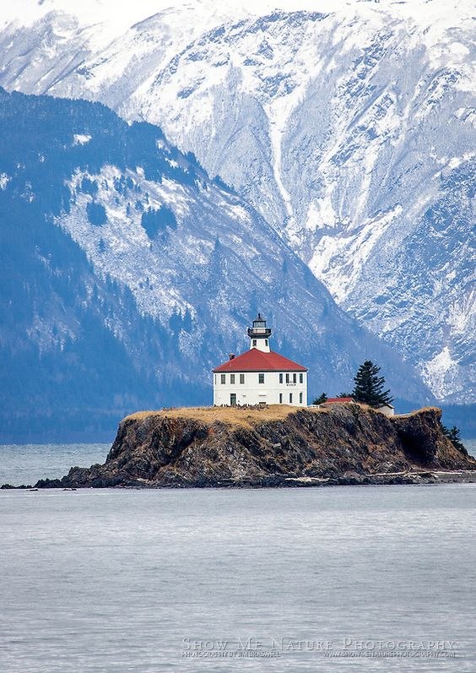



The Five Roles of the Board
The five questions every board needs to ask
2018 Federation of Trainers and Meeting Planners Annual Conference
Juneau, AK

Slide 2
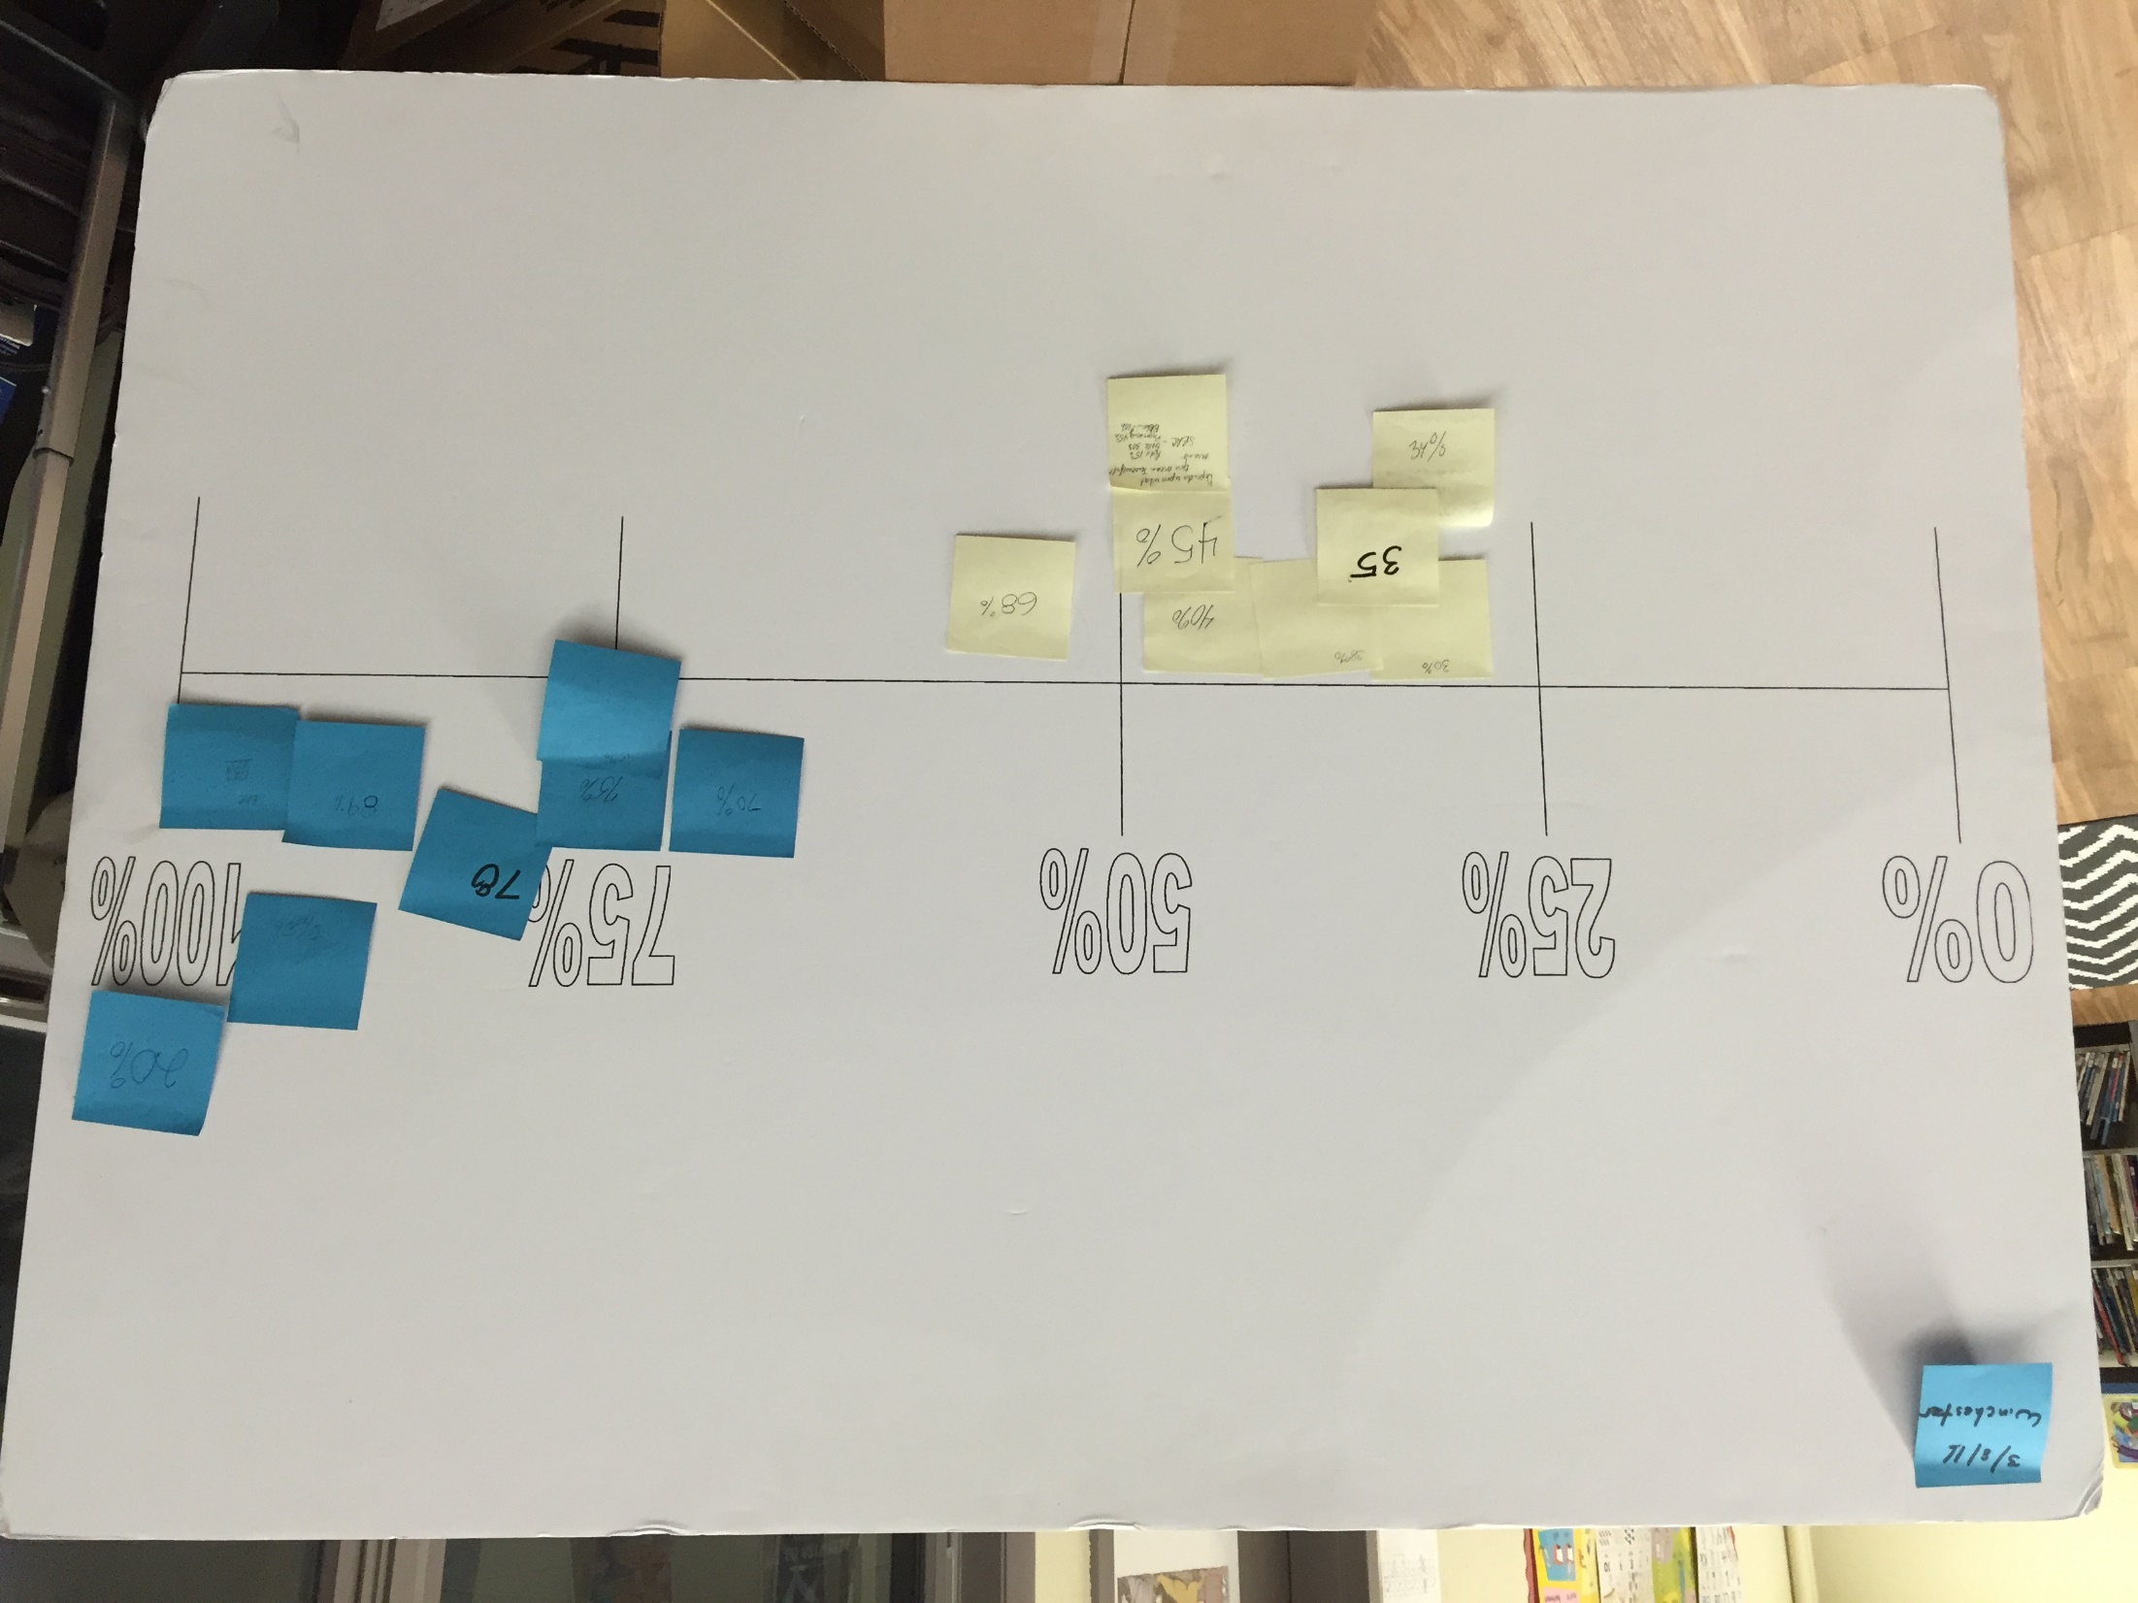

Slide 3

There are 1842 faces on this page
(One for EVERY Child in the North Branford Public Schools)

Slide 4
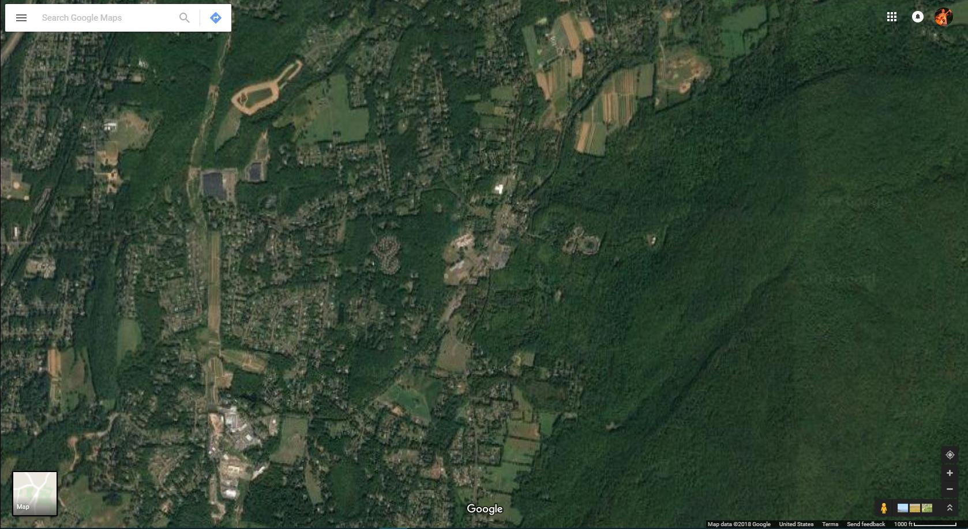

Slide 5
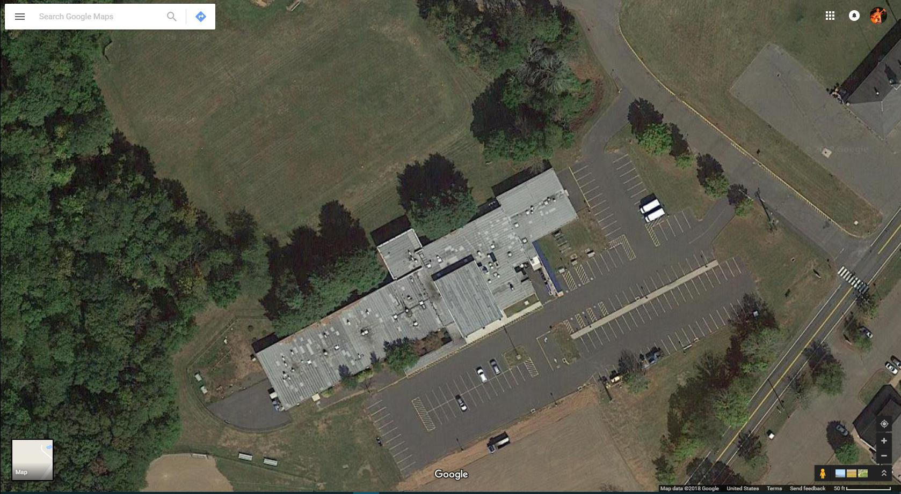

Slide 6
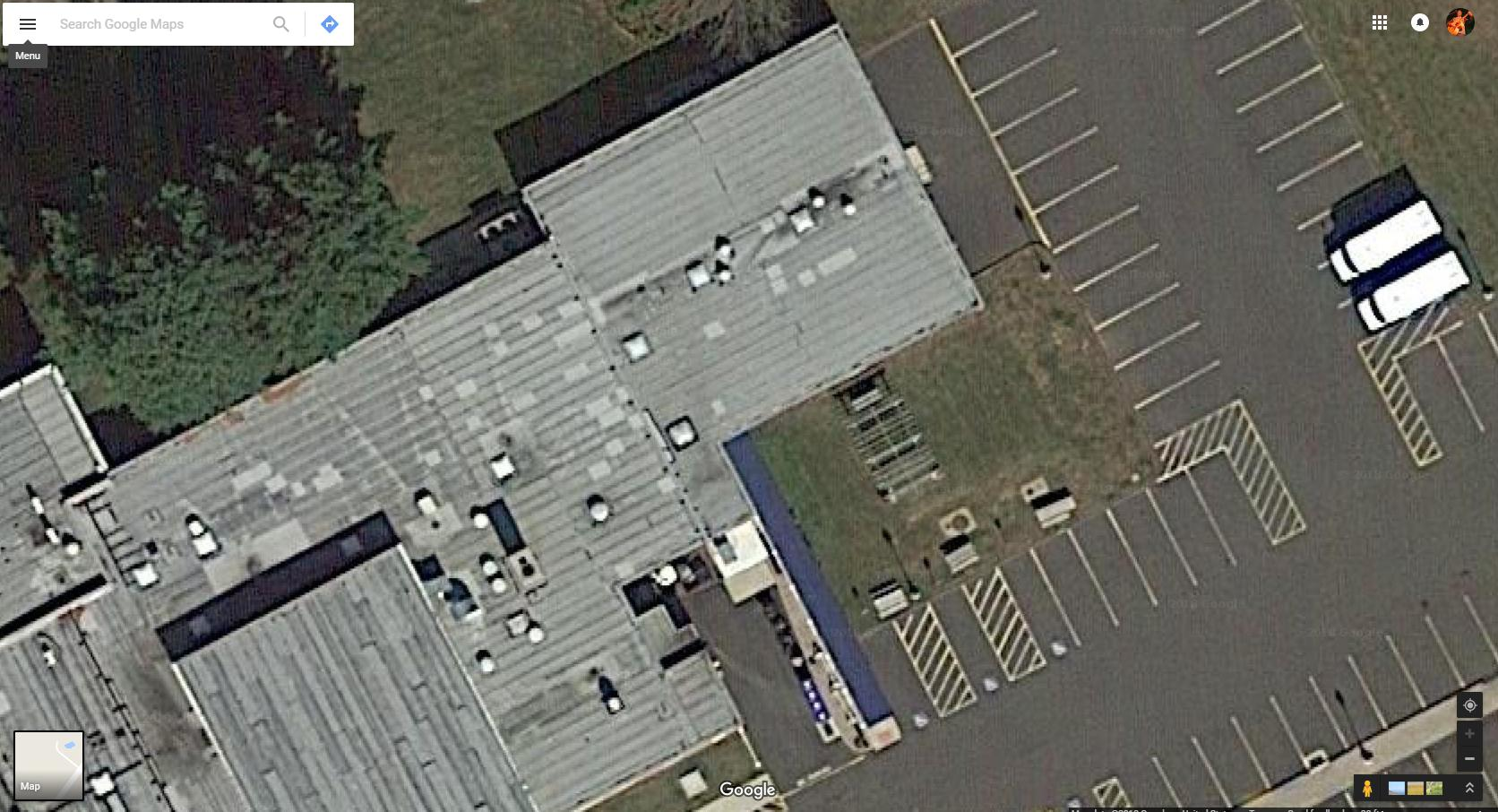

Slide 7
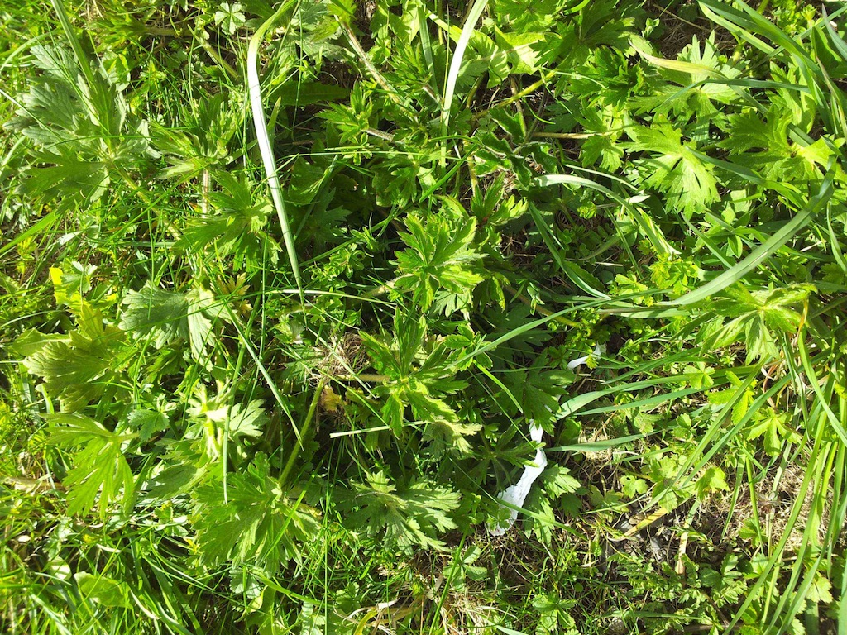

Slide 8
The Work that Only the Board Can do!

Slide 9
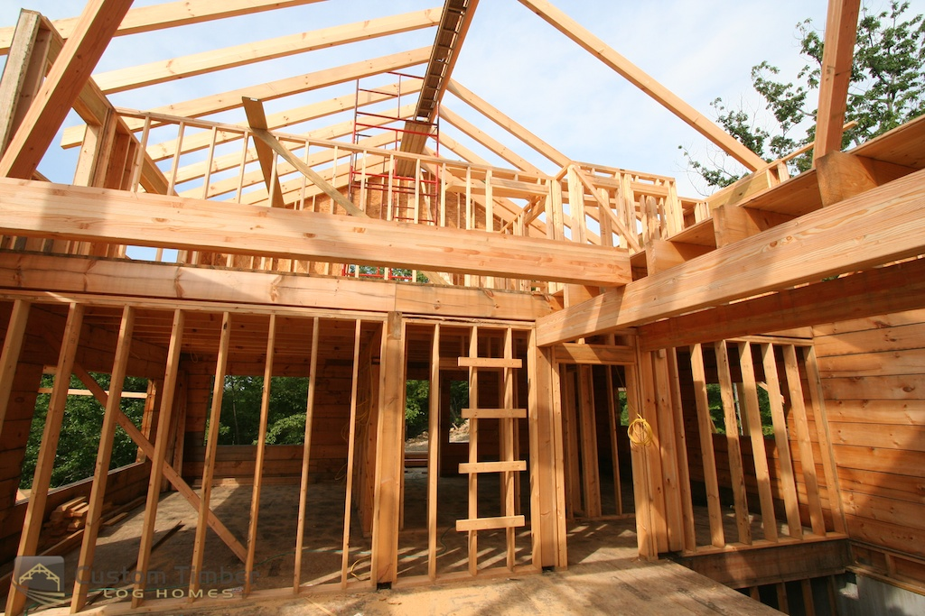

Slide 10

What does it take to build a house?

Slide 11
What does it take to build a house?
Blueprints
Construction Plan
Adequate materials
Check work daily
Communicate with
sub-contractors
Learning curve

Slide 12
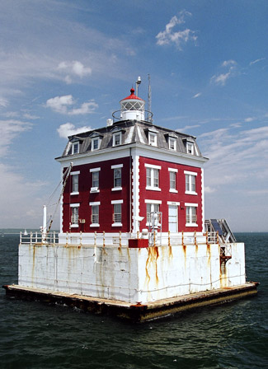
Emerging Understandings About the Role of the Board. . .
Set clear expectations
Hold the system accountable
Create conditions so the work can succeed
Create the public will to succeed
Learn as a Board/Superintendent Team
Notes:
Introduce the five areas here.
Will go into more depth in following slides.

Slide 13
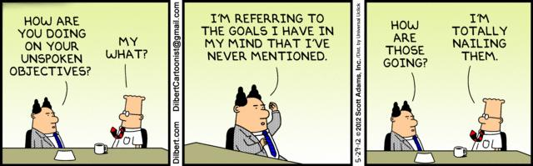
1. Set Clear Expectations. . .
Notes:
Reference a home addition project…

Slide 14
1. Set Clear Expectations. . .
Shared Vision
Provides a “Blue-Print”
Systemic Effect
Notes:
Reference a home addition project…

Slide 15
1. Set Clear Expectations. . .
  Get clear about the greatest student learning needs – the most important content area to improve first
  Believe more is possible and communicate high expectations
  Establish a clear and narrow focus for improvement – clarify improvement goals and specific targets
  Focus on student learning and teaching (Improving teaching as the key strategy for improving learning)
  Ensure that your policy manual reflects your expectations
Notes:
Reference a home addition project…

Slide 16
  What are our greatest hopes for the district in this area?
1. Set Clear Expectations. . .
Question #1
Notes:
Reference a home addition project…

Slide 17

2. Create Conditions for Success

Slide 18
2. Create Conditions for Success
Reciprocity of Accountability
  Richard Elmore, 2000, Building a New Structure for School Leadership
  “Equal and complementary responsibility to assure you have the capacity to do what I am asking you to do.”
  “. . .educate me on the process of learning how to do it. . .”

Slide 19
2. Create Conditions for Success
  Demonstrate commitment to the improvement focus through board actions and decisions
  Support quality professional development
  Stay the course
  Support & connect with districtwide leadership
  Develop and nurture the board/superintendent team leadership
  Ensure all parts of the system are aligned around the learning needs of students (curriculum, instruction, assessment; goals, actions, resource allocation; etc.).
  Align your district policy manual to support these conditions

Slide 20
2. Create Conditions for Success
  What are we willing to support to ensure the expectations can be met?
Notes:
Pressure and support

Slide 21

3. Hold the System Accountable. . .
Notes:
Pressure and support

Slide 22
3. Hold the System Accountable. . .
Mandate
  . . .adopt goals that will improve student achievement. . .
  . . .address educational inequities. . .
  . . .provisions for assessing progress
  . . .ensure student achievement goals have been met
Moral Imperative
Pressure and Support
Notes:
Pressure and support

Slide 23
BLAME

Slide 24
3. Hold the System Accountable. . .
  Use data extensively
  Determine what you will accept as evidence of progress/success
  Monitor progress regularly
  Apply pressure for accountability
  Ensure that policies articulate expectations of the board and district
Notes:
Pressure and support

Slide 25
3. Hold the System Accountable. . .
  What will we accept as evidence of progress toward expected outcomes?
Notes:
Pressure and support

Slide 26
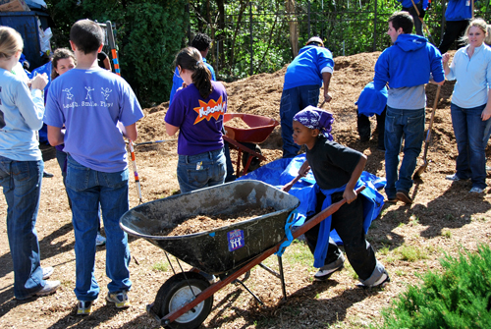
4. Build Public Will

Slide 27
4. Build Public Will
Inform
Involve
Invest

Slide 28
4. Build Public Will
  Create awareness of the need
  Create urgency around the moral purpose of improvement
  Instill hope that it’s possible to change
  Connect with the community
  Ensure that the board has policies related to communications and community involvement

Slide 29
What will we need to do to gain community support for this work?
4. Build Public Will

Slide 30
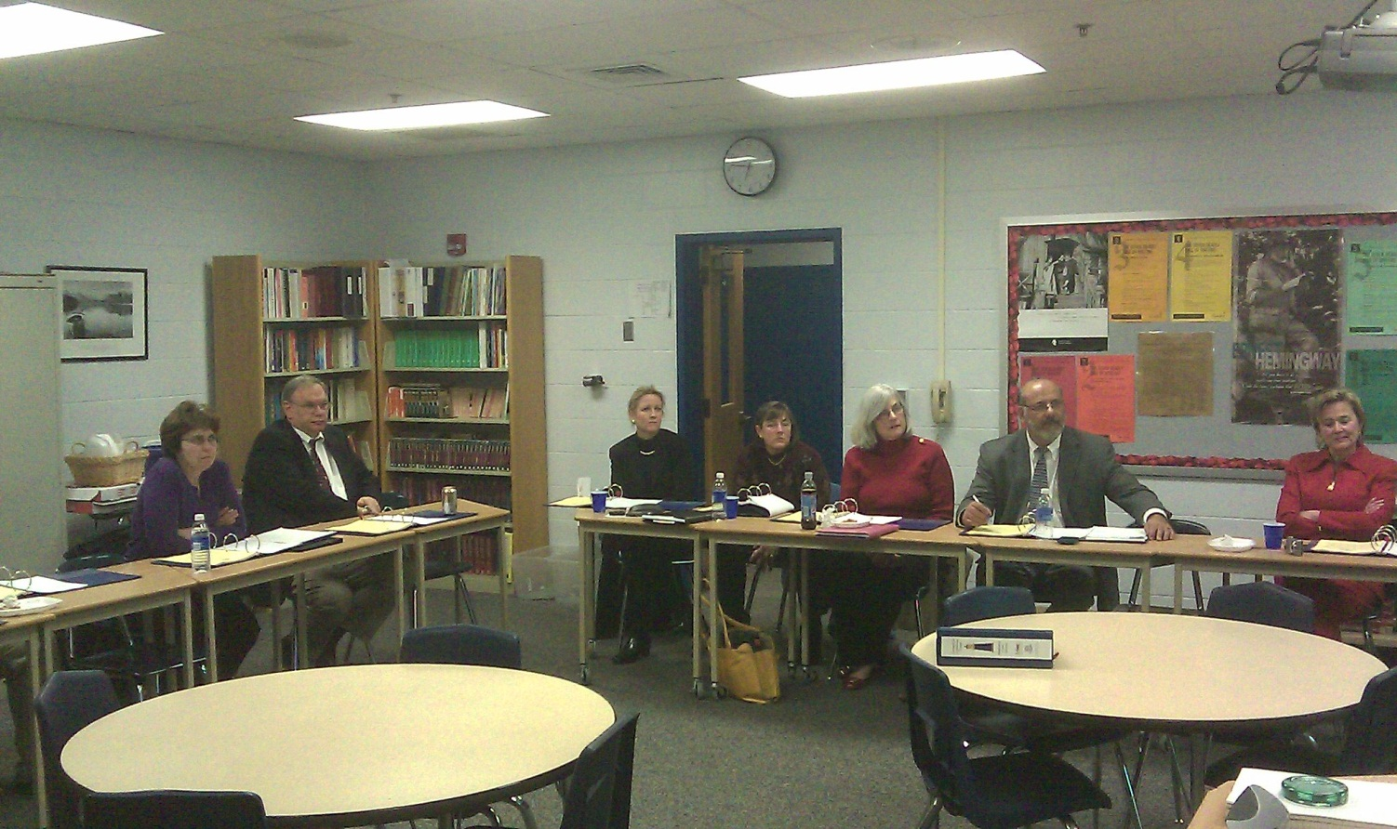
5. Learn Together as a Board Team
Notes:
Underscore that “board learning” was a role that boards in Lighthouse 2 Pilot districts identified as an additional role/bullet as a key board role.

Slide 31
5. Learn Together as a Board Team
  Establish board learning time
  Learn together
  Talk to each other – extensive board conversations
  Develop a willingness and readiness to lead and allow others to lead
Notes:
Underscore that “board learning” was a role that boards in Lighthouse 2 Pilot districts identified as an additional role/bullet as a key board role.

Slide 32
5. Learn Together as a Board Team
  e. Build commitment to the improvement focus through shared information and discussion
  f. Establish board policies that encourage board development
  g. Engage in deliberative policy development – lead through your policies
Notes:
Underscore that “board learning” was a role that boards in Lighthouse 2 Pilot districts identified as an additional role/bullet as a key board role.

Slide 33
5. Learn Together as a Board Team
What information does the board need to ensure the right decisions are made?
Notes:
Underscore that “board learning” was a role that boards in Lighthouse 2 Pilot districts identified as an additional role/bullet as a key board role.

Slide 34
What does it take to build a house?
Blueprints
Construction Plan
Check work daily
Communicate with sub-contractors
Learning curve

Slide 35
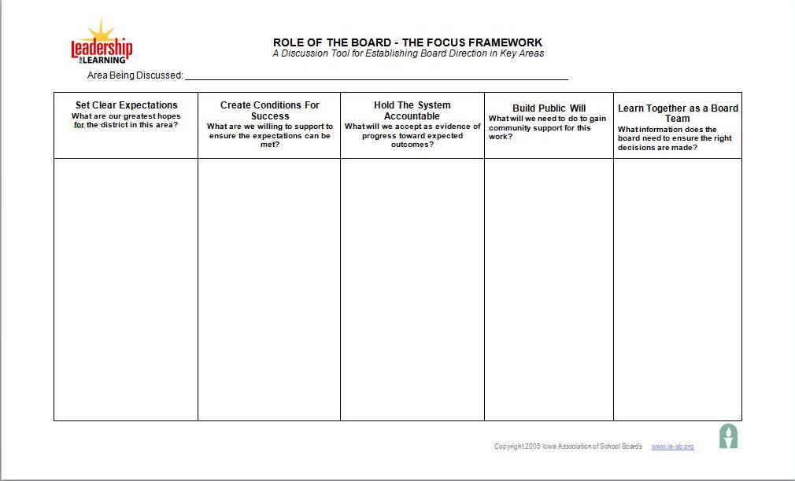
The Role of the Board. . .
Notes:
Warren
Today’s purpose – introduce a tool that’s for awareness level only.
Board/supt team be using this tool (Role of the Board 3 column organizer) over the course of the next couple of years in training and at the board table.
Concept of reciprocity of accountability (shown in 3 column organizer ppt 8)
Emphasize board/supt team will repeatedly use this tool in the coming months
It only includes first 3 roles of the board because board/supt team must have clarity around these three roles (expectations, create conditions for success-support, and hold system accountable) BEFORE they have meaningful content around which to engage public.
Introduce concept of reciprocity of accountability (have to ensure conditions for success exist and be clear about what board/supt. are willing to accept as evidence of progress before they can hold staff & themselves accountable to achieve the expectations.
Use Elmore quote to underscore importance of accountability (hard copy of quote)

Slide 36

www.connecticutlighthouse.org

