Slide 1
Strategic Planning: A Process that Works!
Trainers Conference 2018
Debbie Stair
Assistant Director of Leadership Development
dstair@masb.org

Slide 2

Without goals, and plans to reach them, you are like a ship that has set sail with no destination.
- Fitzhugh Dodson

Slide 3
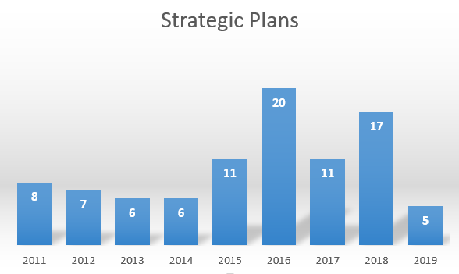
Notes:
What changed from 2014 to 2015?
Old Process – 3 steps
Have a conversation
Send a proposal
Follow-up
New Process – 5 steps
Promotion (ad & video)
Have a conversation
Send a proposal
Follow-up
Schedule a presentation
Follow-up
Most importantly – a beefed up process

Slide 4

Cycle of Healthy Governance
Board Self-Evaluation
Superintendent Evaluation
Goal Setting/Strategic Planning
Notes:
In 2014-2015 we started marketing our services at conference breakout sessions at MASA & MASB
MASB recommends these 3 items on an annual basis.

Slide 5
Board Self-Assessment Excerpts
Our Board:
Clearly articulates vision and mission statements for the district, which are the basis for measurable goals
Considers community perspectives, including residents without children in the district, in determining district priorities
Defines clear goals for student achievement and effective instruction
Reviews annually the progress of the long and short-term goals
Approves and monitors budget based on district’s strategic priorities
Superintendent Evaluation Excerpts
Progress Toward District-Wide Goals (10%)
Progress made by the school district in meeting the goals set forth in the school district’s school improvement plans is a required component for superintendent evaluation.
  Ineffective – progress was made on fewer than 60% of goals
  Minimally Effective – progress was made on 60-74% of goals
  Effective – progress was made on 75-89% of goals
  Highly Effective – progress was made on 90% or more of goals
Notes:
In 2015-2016 new legislation mandates Superintendent Evaluation and board/supt training in their chosen tool beginning with the 2016-2017 school year.
The items are so inter-related that you can see MASB’s new self-assessment tool includes a number of items regarding goal-setting.
Let’s look more closely at the board’s role in goal-setting.
Supt evaluation tool will include references to goals in the rubrics.

Slide 6


Slide 7
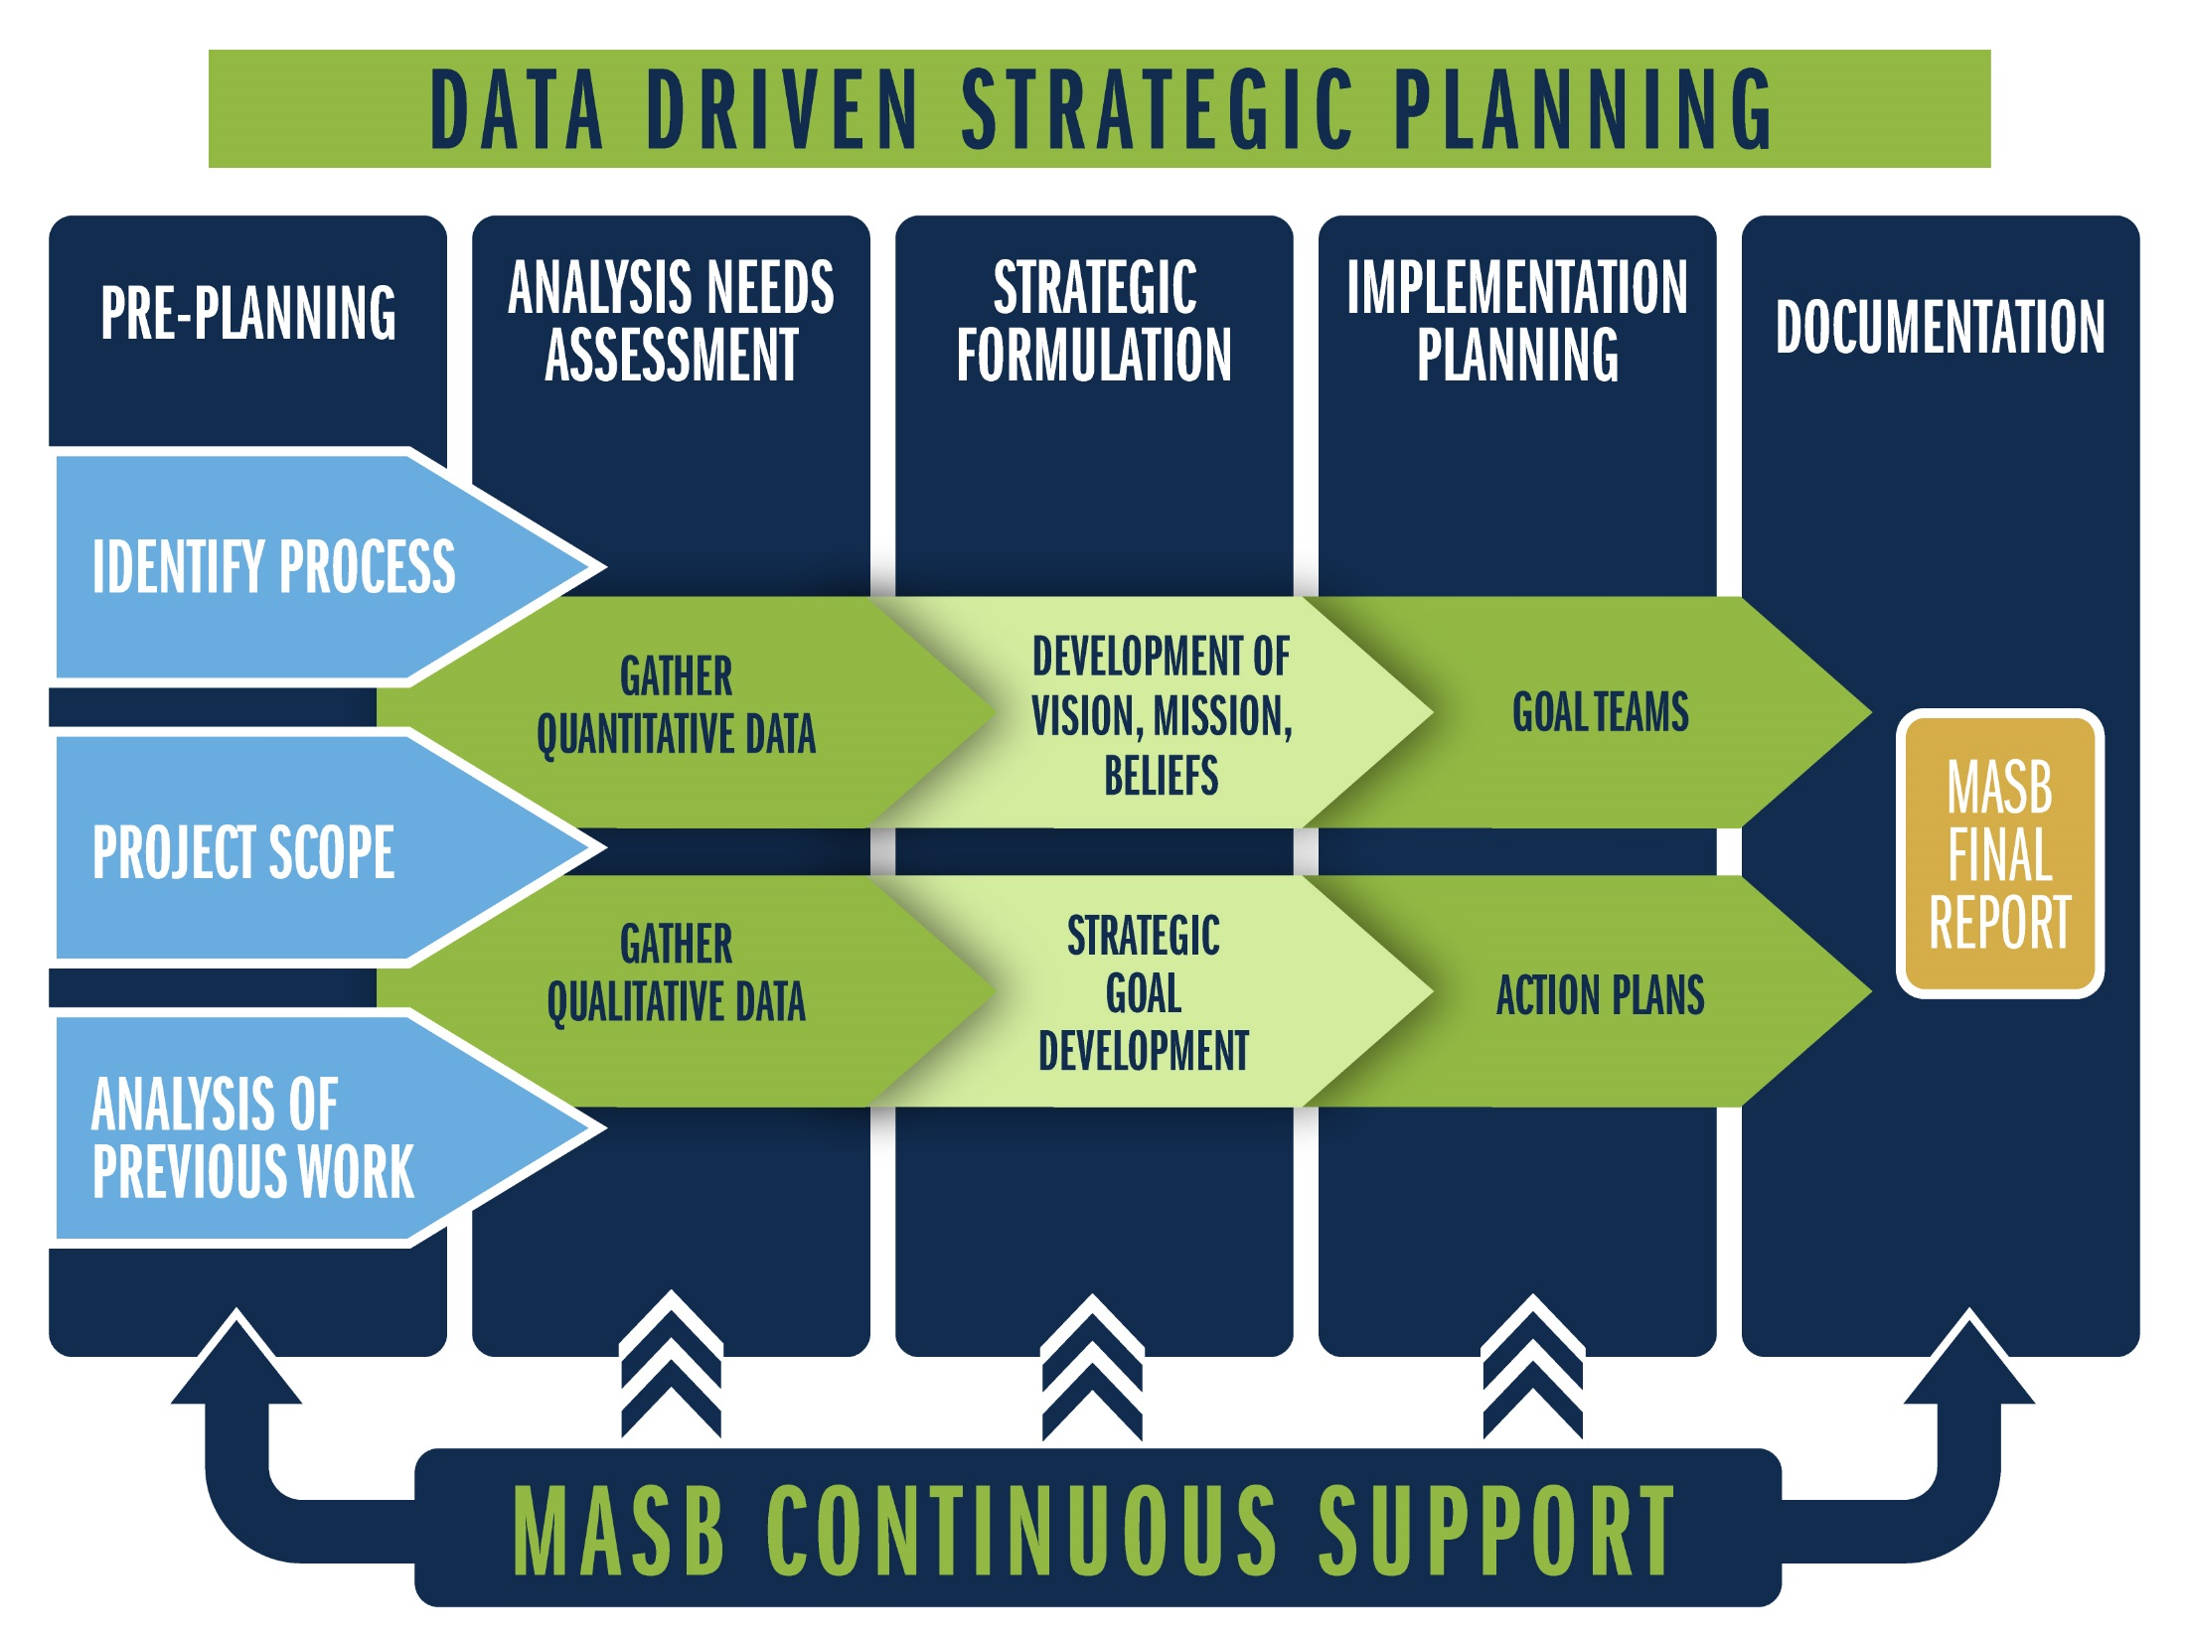

Slide 8

Jan
Feb
Mar
May
Stakeholder Input Completion
Board of Education Approval of the Plan
Apr
Board of Education Presentation
Planning Retreat
Approval of the Process
Stakeholder Input Begins
Data Collection & Preparation
Data Analysis
Implementation Workshop
Notes:
4-5 month process

Slide 9

Included District Services
    Templates for Press Releases
    Templates for Invitations
      Input Sessions
      Electronic Input
      Planning Retreat
    Meeting Updates
Notes:
For consultants – templates for all district communications

Slide 10

Analysis/Needs Assessment Phase
Stakeholder input (qualitative/perceptual data)
Face-to-Face Input Sessions
Electronic survey
Educational data audit (quantitative data)
Demographic
Student Achievement
Financial
Personnel
Notes:
Face-to-Face Input Sessions: community/parent/staff/student input
Electronic survey: all stakeholders
Both cover the same 4 key questions: strengths, areas for improvement, obstacles for success, vision

Slide 11

Planning Team Retreat
    Environmental scan
    Review current initiatives
    Review the data
    Develop mission, vision and beliefs
    Develop strategic goal areas
    Generate goal area objectives
    Generate/finalize goal statements
    Identify next steps
Notes:
40+ Stakeholders - cross representation of all groups
Develop/review/revise/renew vision, mission, and beliefs

Slide 12
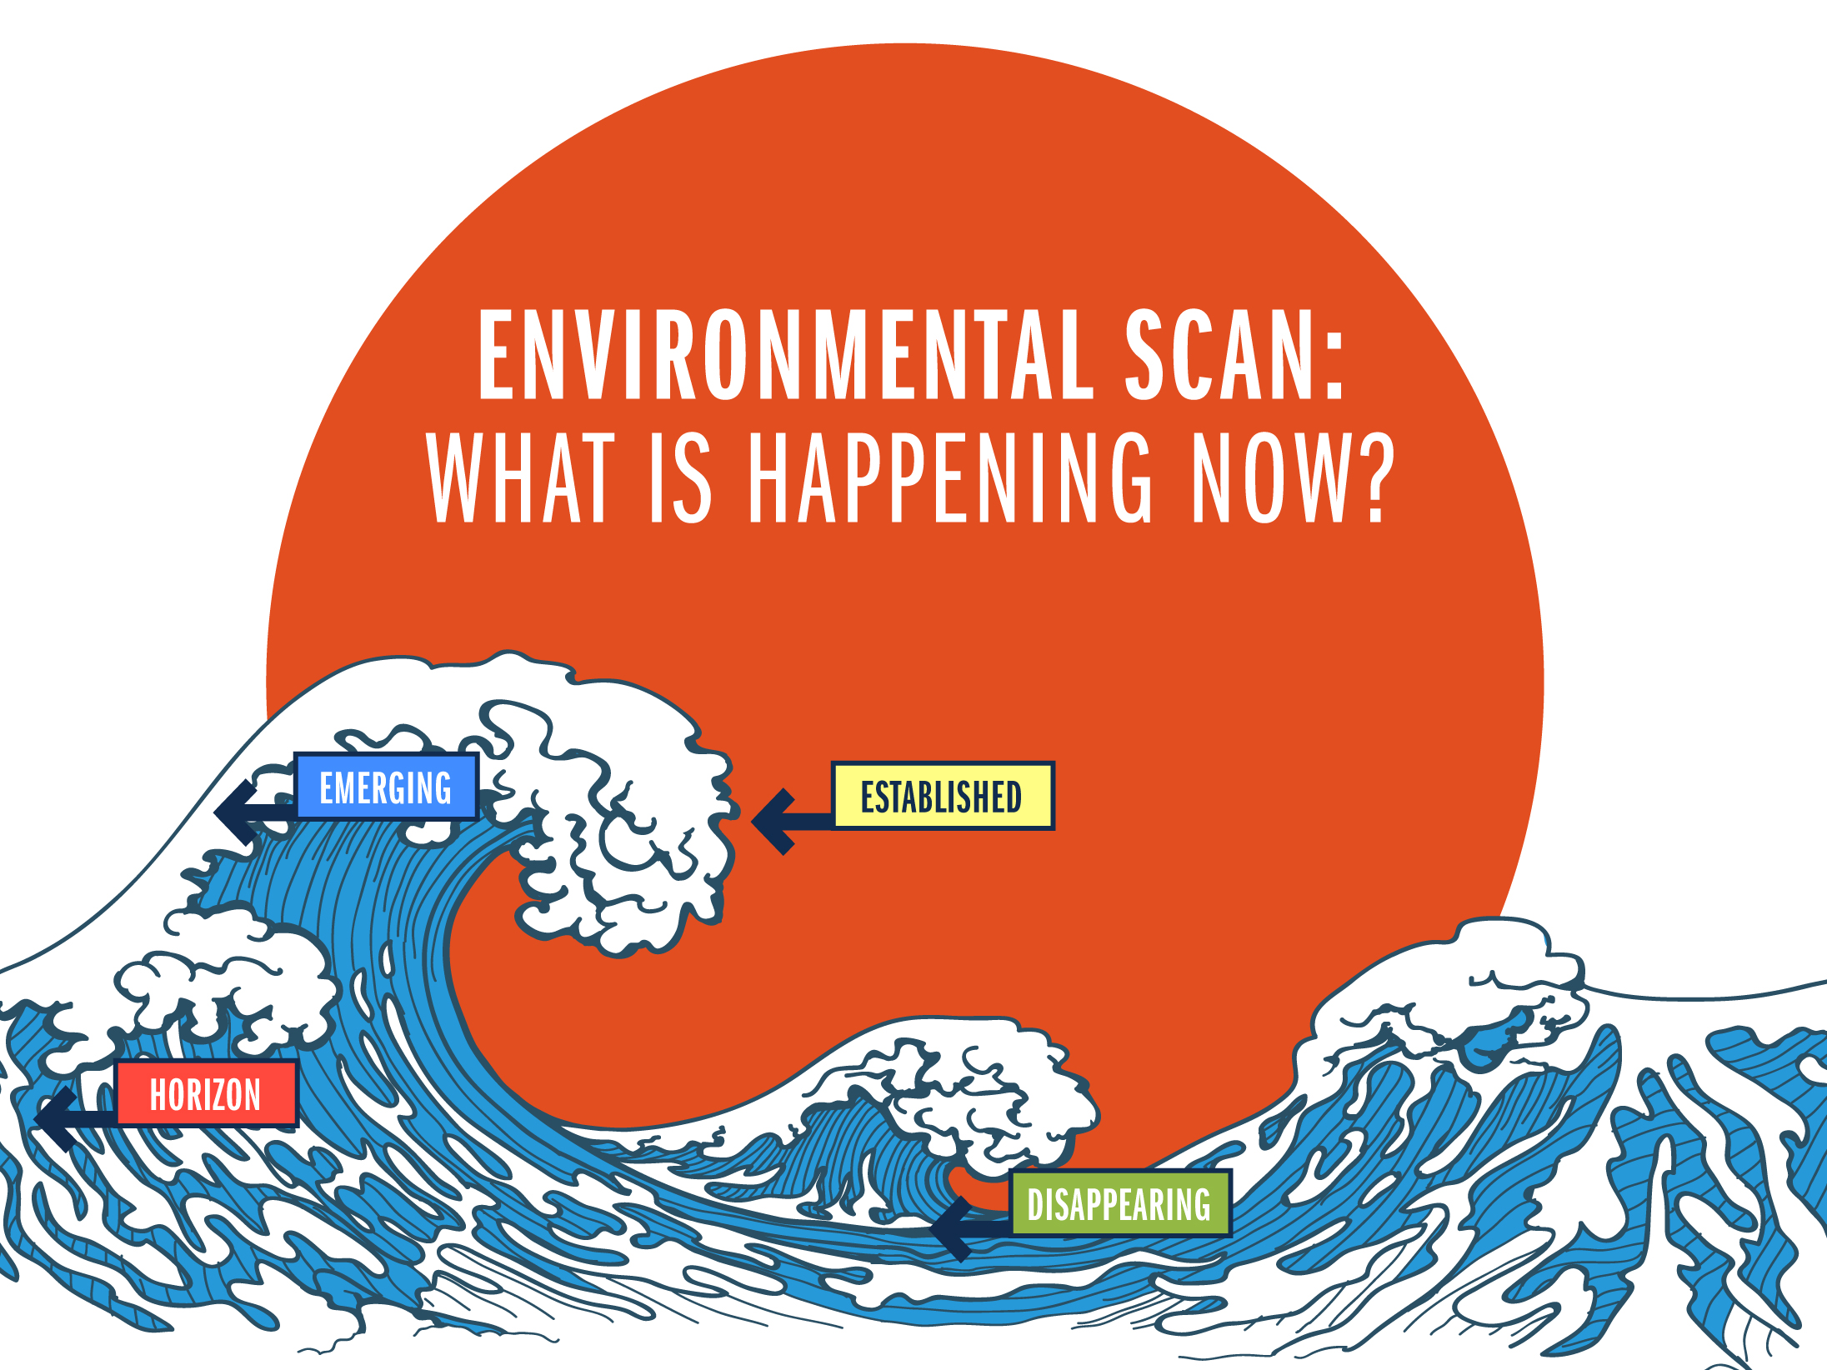

Slide 13
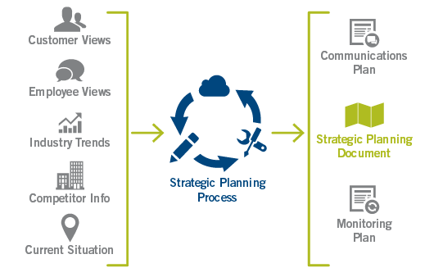
From Development to Implementation

Slide 14


Slide 15

Implementation Planning
    Finalize goal statements if necessary
    Finalize first year objectives
    Calendar first year objectives
    Develop action plans
    Develop a board monitoring process
    Explore a communications plan
Notes:
Supt/staff align goals/objectives with School Improvement Plans

Slide 16

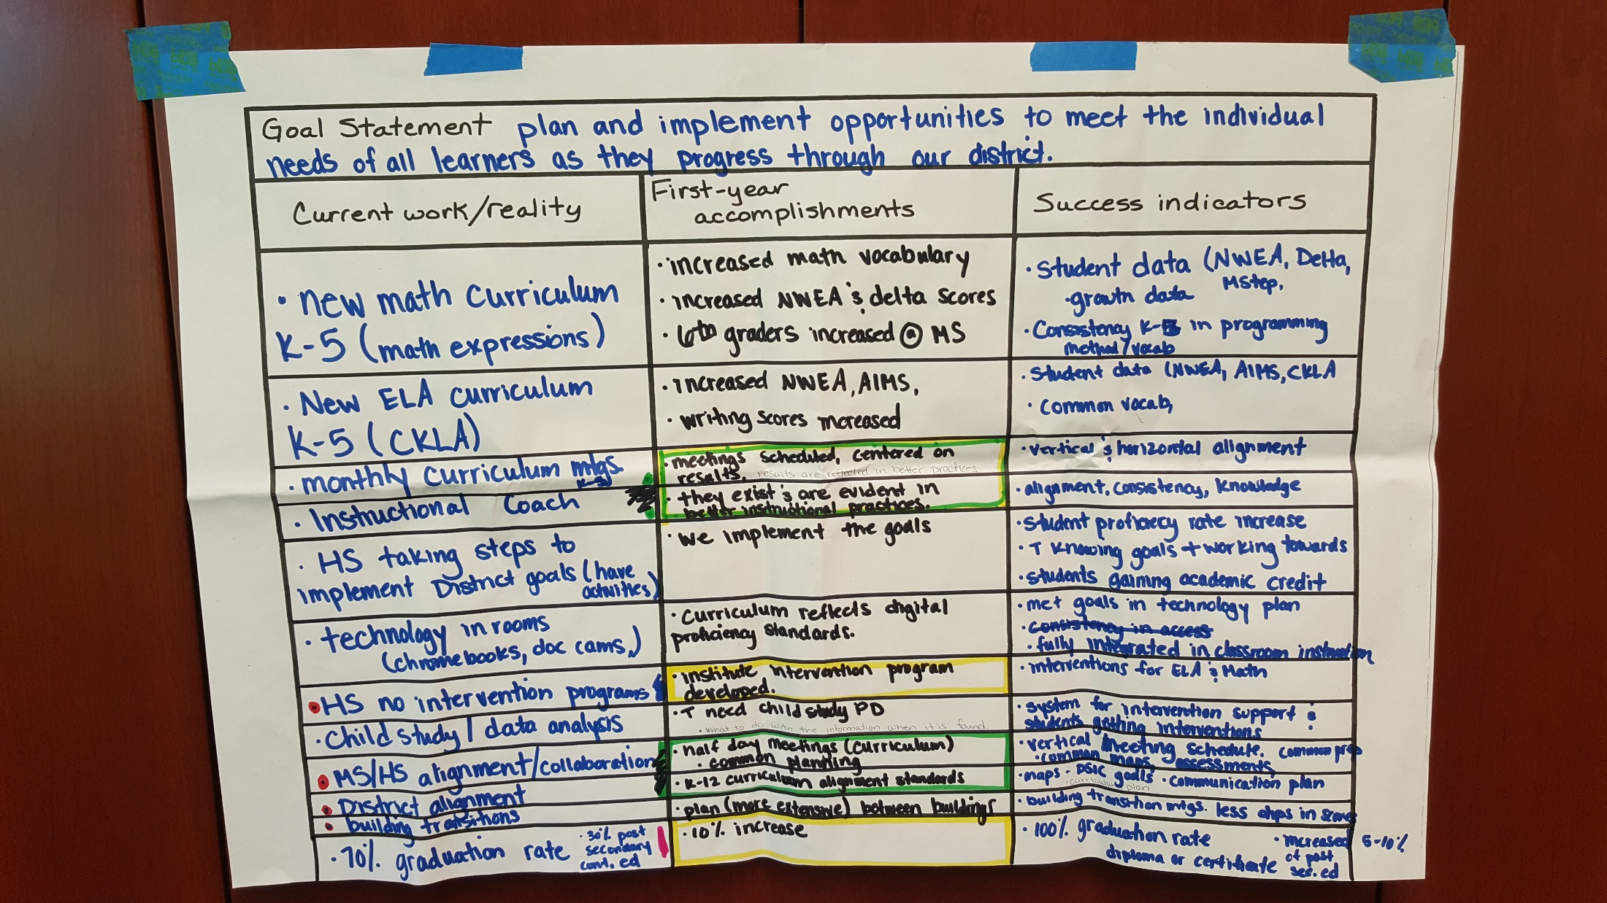

Slide 17
First Year Accomplishments
1st Quarter
2nd Quarter
3rd Quarter
4th Quarter
Personnel
Audit administrative job descriptions.
Determine expectation gaps.
Identify ways to fill gaps.
Hire as needed.
Academics
Review process documents and data. Refine/restructure as needed.
Collect year-end data and analyze for instructional practices.
Compile current subgroup data and process documents.
Culture
Provide 21st Century Skills training to all staff.
Utilize 21st Century Skills district-wide.
Evaluate, celebrate, and update.
Comm.
Complete needs assessment and determine staffing support.
Develop and implement a centralized communication plan.
Grow two-way communication.
Expand positive stakeholder involvement .
Notes:
Personnel – Conduct an internal review of administrative needs.
Academics – Improve student proficiencies for all subgroups through comprehensive processes.
Culture – Enhance 21st Century Skills.
Communications - Centralize a system for communication.

Slide 18
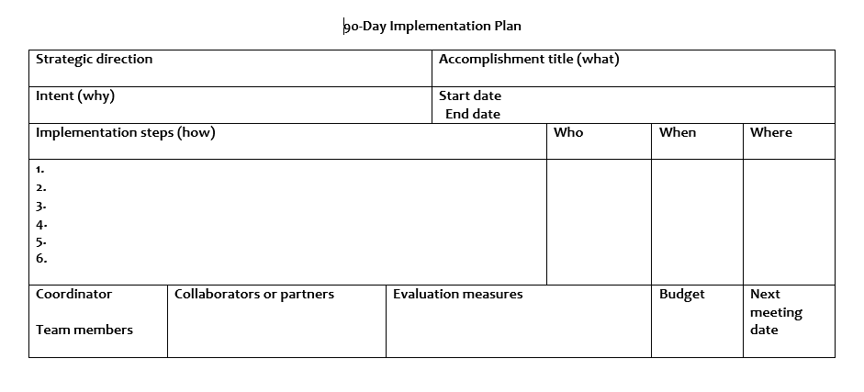

Slide 19

Communicate the Plan!
Notes:
Play video

Slide 20
Communicating the Plan
Communicate Early & Often!
Provide Strategic Plan documents to Board prior to meeting & adoption
Invite Retreat Team & community to Board meeting
Press Release prior to adoption
Board Adoption
Press Release following adoption
Distribute 1-pager to Board, staff, community & press
Gather building administrators & school improvement leaders to develop district-wide implementation & communication plans
  Create opportunities for involvement & share
Have building administrators meet with their teams to fully develop building-wide implementation & communication plans
  Create opportunities for involvement & share
Share progress of plan with staff at welcome back event
Share progress of plan with families when school starts
  Create opportunities for involvement & share
Share progress on an ongoing basis
Notes:
You cannot communicate often enough!
broken record effect – say it again and again
Use every avenue available to you – not all electronic!

Slide 21

Vestaburg Community School
Strategic Plan Summary │ 2018-2023
Mission
Belief Statements
The mission of Vestaburg Community School is to build a foundation and prepare students for their future.
We believe…
All students can learn.
The learning environment should be safe and non-threatening, built on mutual respect and positive behavior.
Learning needs to be engaging, individualized, and prepare students for their future.
Parent and community involvement are vital to the success of the school.
Significant learning is achieved through meaningful relationships.
Addressing educational and social needs of all children leads to success.
Vision
The Vision of Vestaburg Community School is to empower all to create and achieve their goals and dreams.
Strategic Focus Areas
Academics/
Programs
Culture/Learning
Environment/
Communication Engagement
Board of Education
Lynn VanSickler, President
Charlotte Davis, Vice-President
Ivan Palmer, Secretary
Mark Alexander, Treasurer
Cornelius Bornman, Trustee
Carol Herman, Trustee
Brian Zinn, Trustee
Personnel/Leadership
Operations
Superintendent
Brandon Hubbard
Approved by Vestaburg Community School Board of Education on __________.

Slide 22
Vestaburg Community School
Strategic Plan Summary │ 2018-2023
Academics/Programs
Operations
Culture/Learning Environment
Communication/Engagement
Goal Statement: Expand learning opportunities that promote growth and increase student achievement.
First Year Objectives:
Improve/expand Special Education programming
Ensure interventions at all levels/subjects
Boost First Good Instruction
Goal Statement: Build a learning environment built on a culture of respect.
First Year Objectives:
Complete and implement components of our schoolwide behavior process
Institute administrative systems that encourage schoolwide respect and improve student behavior
Behavior plans are followed with fidelity
Goal Statement: Improve communication and relationships among staff, students, parents, and the community.
First Year Objectives:
Build and maintain a positive relationship between school, community, parents, and students
Execute surveys for recent graduates, alumni, and parent involvement
Develop a comprehensive communications plan
Personnel/Leadership
Operations
Goal Statement: Evaluate and structure programs and personnel assignments to enhance personnel and leadership.
First Year Objectives:
Increase administrative staffing support
Fill all open support staff positions
Increase categorical support and programming
Goal Statement: Maintain and improve facilities to provide a safe, clean environment for learning.
First Year Objectives:
Improve the current ticket system to better address needs
Have two new buses in use and successful inspection of the others
Carry out a successful ballot initiative

Slide 23
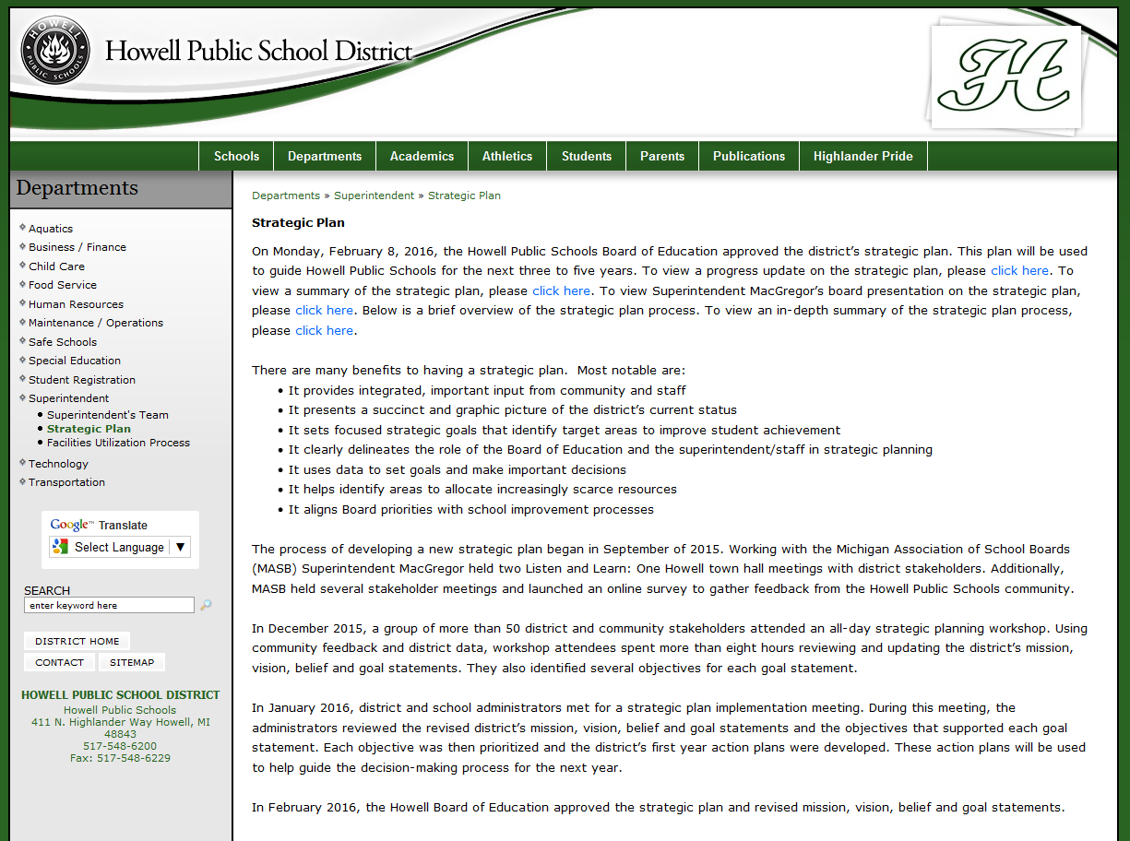

Slide 24


Slide 25

Monitoring Progress
Keep plan front and center
Align goals and budget
Align goals and School Improvement Plans
Create opportunities for involvement
Schedule regular meetings and reports
Celebrate successes
Annual review and renewal

Slide 26
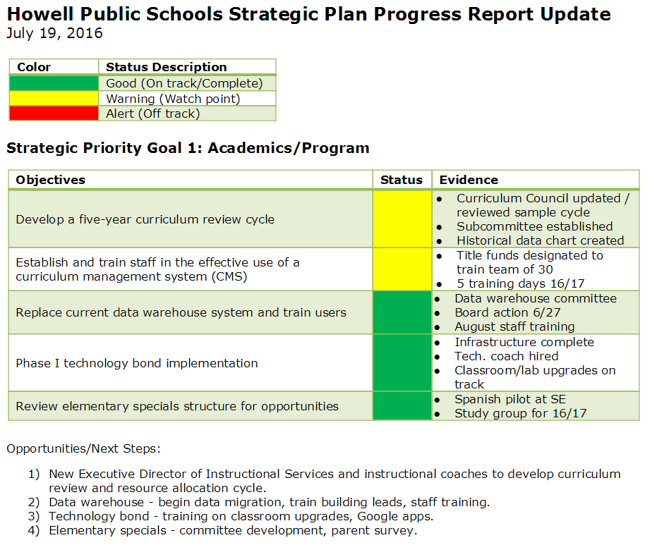
Goal Statement: Howell Public Schools will align and implement an innovative standards-based PreK-12 curriculum.
Notes:
Goal Area 1: Academics/Programs
Goal Statement: Howell Public Schools will align and implement an innovative standards-based PreK-12 curriculum.
First Year Objectives:
Develop five-year curriculum review cycle
Establish and train district and building teams in the effective use of a
curriculum technology tool
Replace current data warehouse and train end users
Phase 1 technology bond implementation
Review elementary specials structure

Slide 27

Documentation Phase
    Summary reports presented
    Adopt plan
    Monitor progress
    Annual renewal
Notes:
Documents provided
Strategic Planning Summary Document
One-page Strategic Plan PR Document

Slide 28


Slide 29


Slide 30
Strategic Plan Year One Review
Sample Agenda
8:00am – 12:00pm
Welcome and introductions
Purpose of today’s meeting
Review process to date
Review and update on progress of each of the five goal statements
Review Feedback Survey results
Brainstorming exercise for each goal statement’s next steps
Reporting out and discussion
Next steps
Notes:
Survey questions –
The new strategic plan has made a positive difference in the district. (Agree/Disagree scale)
What are some specific examples as to how the strategic plan has improved the District?
What are some areas still in need of improvement?
Information about the progress of the strategic plan has been regularly communicated.
Have you attended any of the following events this year to receive district/strategic plan updates? Check all that apply. (Bd mtgs, district/bldg presentations, partnership council, other)
Improving communication between the school community and the District is an ongoing goal. How would you best like to stay informed? Please check all that apply. (email, text msg, smartphone app, newsletter, phone message, social media, web site)
Additional comments you would like to share regarding the strategic plan.

Slide 31

Step 1: Situation Assessment
  Where are we now?
Step 2: Strategic Direction
  Where do we want to be?
Step 3: Implementation Planning
  How do we plan to get there?
Step 4: Monitoring
  How will we monitor progress?
Notes:
Step 1: Situation Assessment – Where are we now?
Understanding the current situation is vital to identifying the
approaches needed to drive success. A full understanding of
the current situation includes an analysis of several areas. What
follows is a sample list of assessment areas and one or two of the
key questions to be answered for each.
Often, planning teams summarize the current situation information
into a SWOT: a summary of the organizations key strengths,
weaknesses, opportunities and threats.
The heart of strategic direction setting is this second step. In our
Drivers Model, the information from the situation assessment is
combined with the understanding of future trends to develop the
vision statement and the mission statement.
• Vision –the organization’s preferred picture of the future
• Mission –the overall purpose of the organization (i.e., what the
organization does, for whom it does it, and the benefit)
The strategic direction setting also includes the defining of
goals and objectives.
• Goals –the broad, long-term aims that define accomplishment
of the mission
• Objectives –specific, quantifiable, realistic targets that measure
the accomplishment of a goal over a specified period of time.
The objectives establish the bar for the rest of the planning effort.
All the strategies, action plans and investments should be focused
on achieving one or more of the plan objectives. Therefore, it is
critical that you select the right objectives for measuring success.
Establishing objectives is perhaps the toughest work in planning.
The planning effort also includes establishing Guiding Principles -
general guidelines that set the foundation for how the organization
will operate. Guiding principles are more than just a statement
of values. Guiding principles also describe the actions the
organization will take based on the values.
Step 3. Implementation Planning – How do we plan to get there?
Once the objectives are established, the next step is to develop
the road map for achieving the direction. For the road map to be
viable, however, it must focus on three areas in particular.
• The barriers to achieving the goals and objectives indicate those
challenges which the organization must overcome to achieve
its strategic direction. Barriers answer the following questions:
“Why haven’t we achieved our goals already? What is standing
in our way?”
• While barriers address the challenges, the critical success
factors identify those key conditions that must be met to
achieve the goals. Critical success factors, typically no fewer
than two and no more than seven per goal, serve as a guide for
determining the strategies to be developed.
• The strategies that are undertaken (i.e., the road map) must
drive achievement of the strategic direction by controlling the
critical success factors and overcoming the barriers.
An important activity at this stage is the prioritization of strategies
to determine the items to focus on first. For each priority strategy,
an action plan is developed which details steps, responsibilities,
costs and timetables. The action plans can then be summarized
to identify resource requirements and to develop a resource plan to
meet those requirements.
Step 4. Monitoring – How will we monitor progress?
Many organizations benefit simply from going through the process
of creating a strategy. At this point, everyone is clear on where
we are going and how we plan to get there. However, the key
value to strategy development comes in the implementation of the
plan. Unfortunately, all too often, strategic plans become space
fillers on an executive’s bookshelf. To prevent this occurrence,
we recommend a structured monitoring process every three-to-six
months.
The structured review involves:
• Assessing progress on strategies
• Grading the current and projected performance against the
objectives
• Identifying changes in the environment, new barriers, additional
critical success factors
• Making adjustments to the objectives
• Re-establishing priorities for strategies, removing strategies and
adding new strategies as needed
While often a sobering process, this detailed level of monitoring
provides a method for ensuring that the long-term strategy stays on
the front burners, despite the pressures of the day-to-day business
operation.

Slide 32

Our Next Steps
Revamp our materials
  Refresh our look
  Continue to refine our data sets
Align our process with the state’s School Improvement reporting
Ongoing follow-up with districts
Implement an evaluation system

Slide 33


