Slide 1
So You Want to Engage in Equity Work...
Let’s Get Started!
Presenters: Tony Arasi, GSBA; Mary Fertakis, NSBA; Nikkie Whaley, AZSBA
NSBA Trainer’s Conference, Thursday, June 21, 2018

Slide 2
Agenda
Our Norms for this Discussion
Definitions: Equality, Equity & Educational Equity
Share Our State’s Equity Journey Story
  Where we were; Where we are; Where we’re going
  Lessons learned; Successes/Challenges
Self-Reflection Prompt and Share Outs
Full Group Discussion/Q & A

Slide 3
NORMS for EQUITY DISCUSSIONS
(Adapted from Glenn Singleton’s Courageous Conversations about Race)
Speak Your Truth
Stay Engaged
Expect to Experience Discomfort
Be Aware of Intent; Own Your Impact
Accept and Expect Non-Closure
Maintain a Learner Stance and Remain Open to New Thinking
Notes:
On the Intent vs. Impact norm: Refer to the Micro-Aggressions document.

Slide 4
What is Equity?
Equality
Equity
Educational Equity
Each person receives the SAME amount of resources, attention and supports.
Each person receives what they NEED in the way of resources, attention and supports.
Each student has access to the resources, supports, and educational rigor they NEED, so outcomes are not predictive based on race, gender, ethnicity, ability, language, family background, or family income.

Slide 5
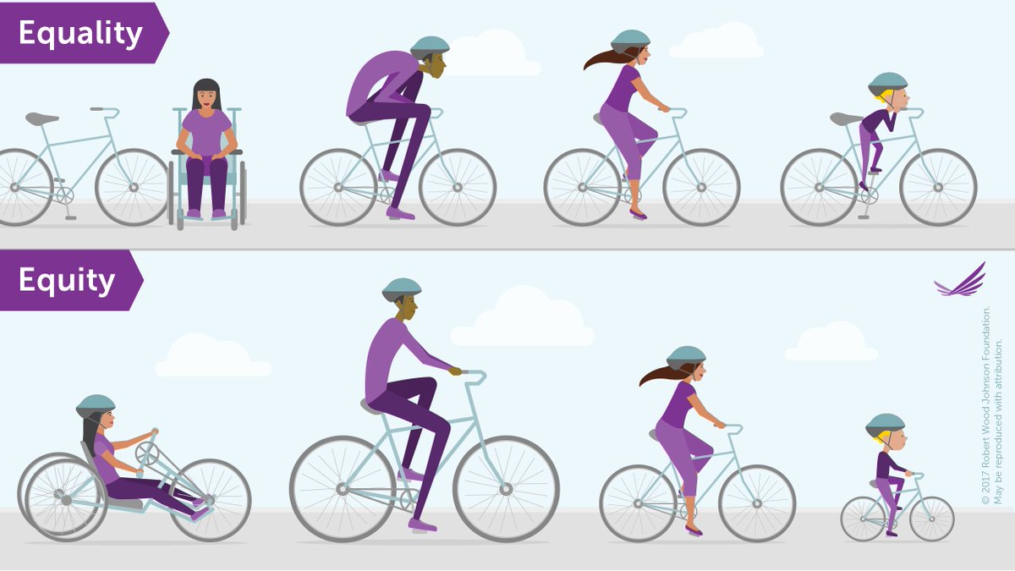
Equality vs. Equity
(Graphic by Robert Wood Johnson Foundation)

Slide 6
Arizona’s Equity Journey
  Where We Were: 2012-14
    Discussions and discord at the board level around representation of POC
    Board seeks out ED with experience working with culturally/ economically diverse communities
    Begin to define equality vs equity. Launch of The Equity Event (2014)
    Folks can “opt-in” to the conversation….or not
  Where We Are: 2015-17
    Discussions on how to embed equity throughout the organization (not just LD)
    Equity is explicitly added to strategic plan as 1 of 3 key goals
    President’s Equity Challenge- Call for all boards to look at equity
    Folks are increasing exposed to equity topics and called to act
  Where We’re Going: 2018-
    Equity Events includes all association departments (LD, Advocacy, Policy, Budget)
    Equity Committee established
    Increased engagement with impacted communities- authentic advocacy vs. elite advocacy
    Development of tools and services to support boards’ equity work

Slide 7
Arizona’s Equity Journey
  Lessons Learned
    Maximize momentum
    Utilize Champions…and naysayers
    Include secondary stakeholders (i.e. the students, families and communities impacted by the decisions of boards).
  Successes/Challenges
    Make it a part of your strategic plan- Commit
    Find multiple entry points- soft serve/hard look
    Be persistent- Change takes time

Slide 8
Georgia’s Equity Journey
“Dipping Our Toe Into the Pool”
Where we were: Prior to July 2015
  Encouraged school districts to focus on equity as they attempt to close the achievement gap.
  Recognition of school districts that were doing good work in this area.
  Starting to build conditions to create district readiness.
  Occasional focus on this topic at our two major conferences.
  Search for new Executive Director.

Slide 9
Georgia’s Equity Journey
“Jumping into the Pool”
Where we are: July 2015 – present
  New Executive Director and leadership staff make this a top priority for our Association.
  Support sought and received from our Association Board of Directors.
  Leading this effort vs. encouraging districts to do more.
  Budgets reflect this focus based on resource allocation.
  Association staff expected to align their programs and resources toward this effort.
  All training staff expected to raise their expertise in this area (exposure to national and state experts and best practices).

Slide 10
Georgia’s Equity Journey
“Diving Deeper into the Pool”
Where We’re Going: 2018 –
  Continue to work with superintendents and school board members so they become comfortable with some of the “discomfort” that comes with discussing this topic (“Courageous Conversations”).
  Major focus area of our conferences, regional workshops and whole board trainings.
  Involving and seeking input from students, parents and other stakeholders.
  Equity focus as part of:
      School District Strategic Plans
      Superintendent Evaluations
      Board Self-Assessments
      Community Engagement Sessions
      Policies

Slide 11
Georgia’s Equity Journey
Lessons Learned
  You have to start somewhere!
  Slow but steady.
  Become comfortable with being uncomfortable.
  There are tremendous resources and individuals doing great work in this area.
Success and Challenges
  Many districts are ready for this – just need to be nudged.
  Many districts are uneasy and reluctant to have the hard conversations that come along with the territory.
  More and more are jumping into the pool but we still have a long way to go.
  This work will never end.
  It’s about EVERY STUDENT, EVERY DAY!

Slide 12
Washington’s Equity Journey
  Where We Were in 2013-14:
    4 school board Directors serving in high ethnically-diverse, adjacent districts started talking about the equity issues they were all experiencing and the need for an equity focus within WSSDA. Started meeting monthly, added more board members from the region to talk about the issues and how to influence WSSDA.
    Met with WSSDA’s Policy and Legal Director to discuss whether the Association would consider supporting development of a model policy related to equity, as well as with the WSSDA President, who took the request to the Board of Directors.
    Discussions began on what support/training would look like. (Separate action: EOGOAC meeting with WSSDA)
  What Happened:
    WSSDA formed partnership with PSESD (regional) and created a Racial Equity Policy Design Team - have held 5 convenings with district teams (2015-18) to support race and equity policy development and implementation (approx. 10 school districts have adopted R&E policies).
    A Race & Equity Caucus was established within WSSDA and meets during every WSSDA conference.
    WSSDA/WASA/AWSP have partnered for the last 3 years to host a state-wide all-day Equity Conference.
    An Equity track has been an option for the past 3 years at the WSSDA Annual Conference.
  Where We’re Going:
    WSSDA BOD adopted Equity principles, members voted to accept; Equity sub-committee of the BOD is developing an action plan for next steps.
    Regional efforts underway to implement Equity principles, and hold convenings and develop Race & Equity policies.

Slide 13
Washington’s Equity Journey
  Lessons Learned:
    Incorporating student voice is critical to the R&E policy process.
    Everyone has a different understanding of “equity” – taking time to define what it means for your school district before undertaking a strategic plan, policy, etc. will keep efforts on track.
    This takes time: relationships and trust-building are essential – go slow to go fast.
    The Board has both a technical and leadership role in this process – they need to understand and fulfill both.
  Successes/Challenges:
    Ripple effect underway - other regions starting the work.
    Implicit bias is always present – self-reflection is essential and will be on-going.
    This is a conversation that will not end – takes a strong commitment and persistence.
    Pushback will happen in some way, shape or form.
    Requires commitment to funding/resources or it will not happen.

Slide 14
Self- Reflection
Prompts:
A) What are the potential entry points for engaging in Equity work in your State Association and with your Members? (local context matters!)
B) What are 3 things that you need in order to engage in, or continue to engage in, Equity work in your State Association and with your Members?
-> Share your responses with your table mates
-> Full group discussion

Slide 15

Equity Work is Never Finished!

Slide 16

We can do this!
Thank you for attending this session!
Tony Arasi: tarasi@gsba.com
Mary Fertakis: mfertakisconsulting@gmail.com
Nikkie Whaley: nwhaley@azsba.org

