Slide 1
Addressing the Elephant(s) in the Room:
Effective Facilitation Strategies for Equity Conversations
NSBA Trainer’s Conference, June 22, 2018
Presenters: Verjeana Jacobs, NSBA; Mary Fertakis, NSBA; Colleen Miller, WSSDA

Slide 2
Agenda
1. Speaker Introductions
2. Norms for Racial Equity Conversations
3. Definitions/Terminology
4. Confronting Our Biases – Personal Work Before Working with Others
5. Strategies for Effective Equity Conversations/Presentations
6. Responding to Pushback
6. Q & A

Slide 3
NORMS for EQUITY DISCUSSIONS
(ADapted from Glenn Singleton’s Courageous Conversations about Race)
Speak Your Truth
Stay Engaged
Expect to Experience Discomfort
Be Aware of Intent; Own Your Impact
Accept and Expect Non-Closure
Maintain a Learner Stance and Remain Open to New Thinking
Notes:
On the Intent vs. Impact norm: Refer to the Micro-Aggressions document.

Slide 4
Learning Continuum for
Race-Focused Work
(Annie E. Casey Foundation – RESPECT Initiative)
Color-Blind
Diversity-Only
Race-Tentative
Equity-Focused

Slide 5
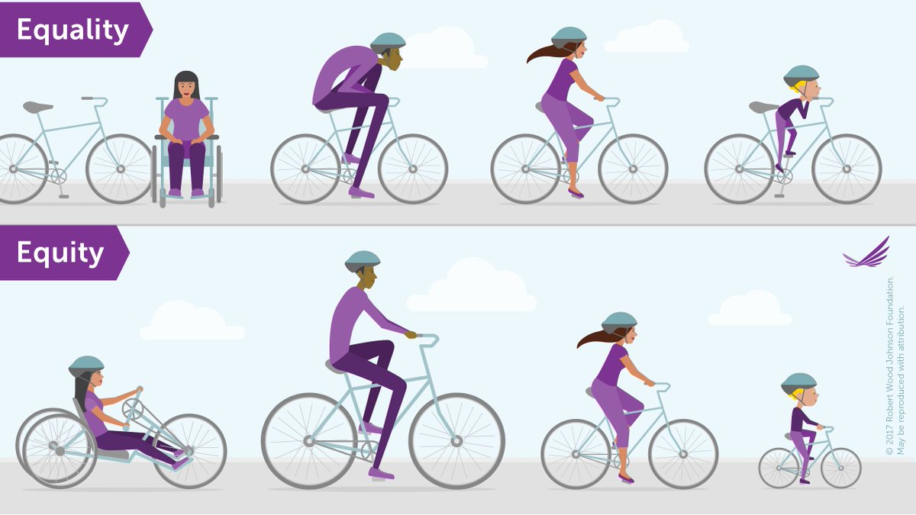
Equality vs. Equity
(Graphic by Robert Wood Johnson Foundation)

Slide 6
Important terms in race & Equity Work
Race
Racism
Prejudice
Implicit Bias
Stereotype Threat
Institutional Racism
Structural Racism
Internalized Racism
Privilege/White Privilege
White Fragility
Micro and Macro-Aggressions (Interpersonal Racism)
Internalized Racial Superiority
Internalized Racial Oppression
White Dominant Culture
White Supremacist Culture

Slide 7
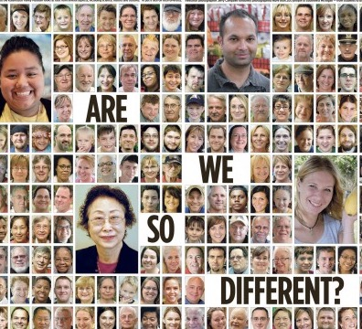
RACE
Race is NOT biological.
Race is a social-political construction that creates a “hierarchy” of what is desirable (beauty, mannerisms, language, culture, etc.).
It’s intent is to concentrate power and legitimize dominance over people of color.

Slide 8
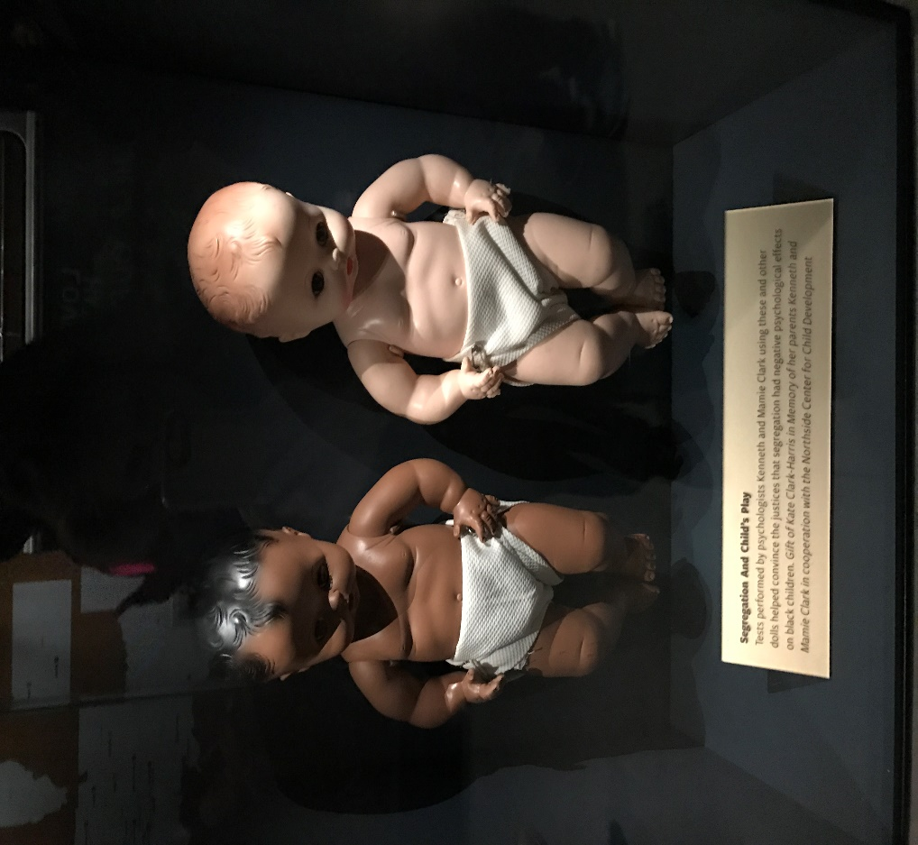
Internalized Racism
Drs. Kenneth & Mamie Clark developed The Doll Test, which showed the negative, psychological effects of racism on children 3-7 years old.
Consistently, Black children chose the White doll as their preferred one and assigned positive characteristics to it rather than the Black doll.
Their research was part of the testimony during the Brown v. Board of Education trial and was cited in the Court’s written decision as to why the “separate but equal” policy was damaging to children.

Slide 9
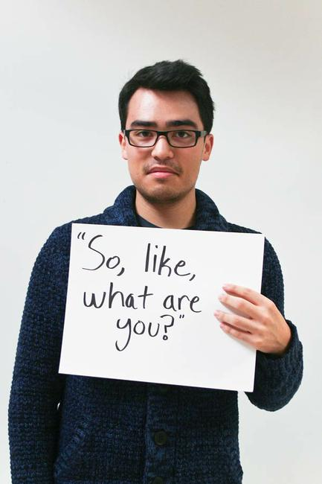
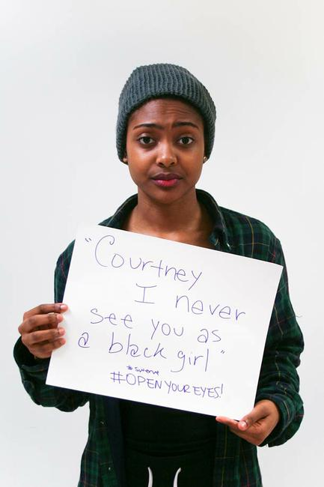
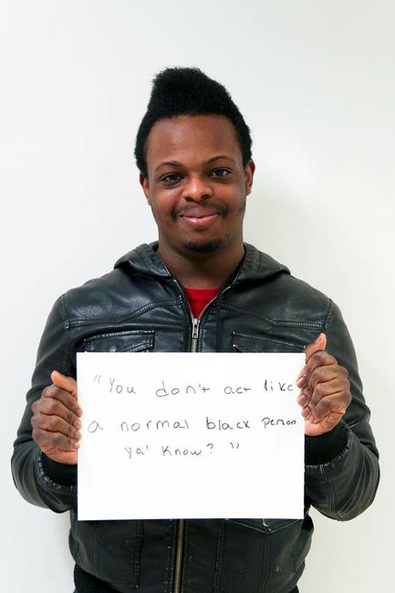
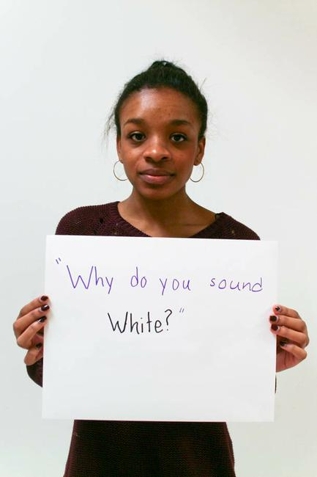
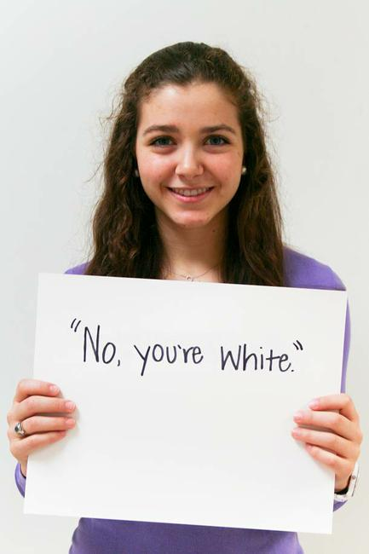
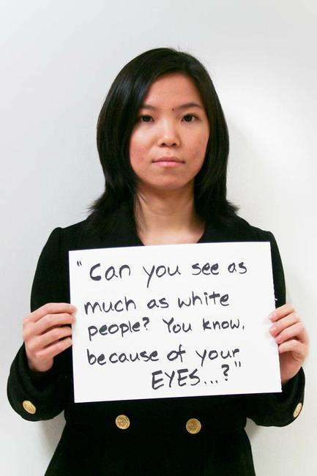
Interpersonal Racism
(micro-aggressions)
“So like – what are you?” “Courtney, I never see “You don’t act like a normal Black
you as a Black girl.” person, ya know.”
“Why do you “Can you see as much “No…you’re
sound White?” as White people…you White.”
know, because of your eyes?”
eyes?”

Slide 10
Racism
(Example: Criminal Justice System)
Police stops: 2x more for Blacks than Whites
Police searches: 3x more for Blacks/Hispanics
Use of force: Police more likely to use on Blacks
Juvenile Arrests: 2x more for Black youth
Gay/Transgender Arrests: Far higher than their percentage of the population (60% are of color)
Drug Arrests: Blacks/Whites use at the same rates, but Blacks are arrested 2x more
Marijuana: Blacks are arrested 3.73x more
Pre-Trial Release: Blacks more likely to be incarcerated while waiting for trial
Prosecution Charges: 2x more mandatory minimum sentences for Blacks for the same crimes as Whites
Prison v. Community Service: 2x more imprisoned if Black; Whites have higher community service rates
Length of Sentence: Blacks more likely to have longer sentences than Whites
Women: Blacks incarcerated 3x higher than Whites
Life w/out Parole: Over 65% are Blacks - and for non-violent offences
Criminal Records: Whites with a record have a better chance of getting a job than a Black w/out a record.
Voting: 1 in 13 Blacks can’t vote vs. 1 in 56 non-Black voters due to felony disenfranchisement.

Slide 11
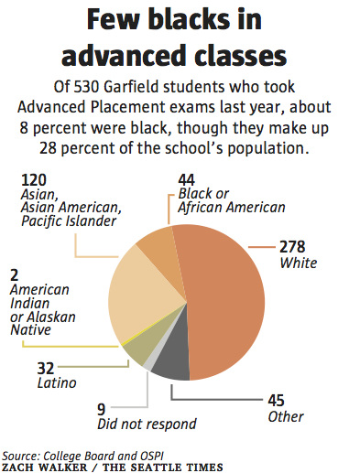
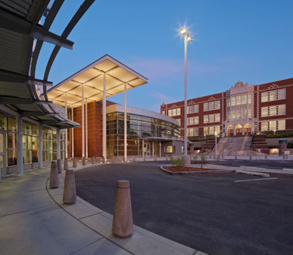
Structural Racism
“When I first got here a White parent told me, ‘We run this school. You’re just a caretaker, and don’t ever forget it.’ "
“Students of different races inhabit separate worlds. The school’s advanced-track classes are mostly white, as is its well-heeled parent fundraising group, and its annual crop of National Merit Scholars.”
“An area students call the “black balcony.”
The school’s “white hallway” stretches one floor above.”

Slide 12
Institutional Racism
(The 13th Amendment)
“Neither slavery nor involuntary servitude, except as a punishment for crime whereof the party shall have been duly convicted, shall exist within the United States, or any place subject to their jurisdiction.”
Slavery is not mentioned in the Constitution prior to the 13th Amendment – it’s inclusion provides legal justification for its practice (as a means of punishment).
Makes slavery legal in prisons. Led to local governments developing convict leasing programs that generated revenue and increased the profit margins for businesses using convict labor.
Incentivized arresting Black and Brown people for an almost-free labor source and increased the growth of the prison industrial complex. (Black Codes -> Vagrancy Laws -> Convict Leasing -> Chain Gangs -> Low Wage Prison Labor)
The private prison industry grosses billions of dollars p/yr. (Full facilities = maximum profits)
The United States currently has more incarcerated people than any other country in the world.

Slide 13
Confronting our biases – personal work
For White People:
For People of Color:
Do not expect POC to “teach” you about bias, racism, etc. – Google/research it yourself.
Read; Reflect; Discuss; Caucus.
Take the IAT (Implicit Bias Test) on-line.
Allow yourself to experience the Stages of Grief.
Put yourself in situations where you are the minority and just listen.
Approach this work from a place of humility. Accept that this is a life-long process and will take on-going, personal commitment to un-learn what has been deeply programmed inside of you.
Randomly read an article current or historical about a group different than yourself.
Go to an event sponsored by or hosted by a group different than yourself (ie. Church, an HBCU) or museum or other cultural site.
Bolder idea – convene a group of people to talk about race and poverty in a small setting.
Personal: “An initially unconscious journey – the intersection/connectedness of career and personal experiences led to a conscious, purposeful and intentional commitment… Corrections, Law school, University professor, School Board, Parent…”

Slide 14
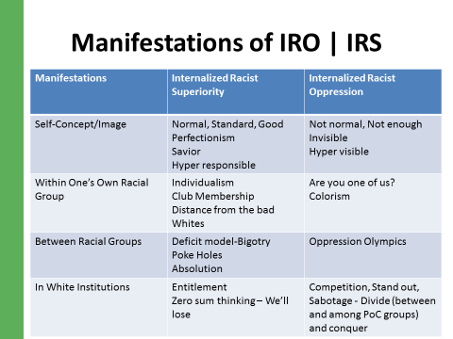

Slide 15
REFLECTION
What are your thoughts about what you have heard so far?
On a scale of 1-10, what is your confidence level with leading a race and equity discussion?
What personal work do you need to do and/or what professional development would be helpful to increase your confidence level?

Slide 16
Strategies for effective conversations
Frame the Conversation in the context of the Norms.
Conduct an icebreaker that creates an empathetic environment (i.e. Standing in Another’s Shoes).
Ideally, have both a Person of Color and a White person as co-facilitators.
Short agenda with most of the time allocated for discussion. Meet monthly for at least 2 hrs.
Ensure that a common definition of Equity/Racial Equity is in place.
Ensure that there is a common understanding of the terminology being used.
Provide an opportunity for Caucusing with your racial affinity group (structured & facilitated).
Provide time for personal, small group and whole group reflection.

Slide 17
Strategies for effective conversations
The basics - hone the art/skill of listening.
Be intentional, purposeful – ask yourself - what is the desired outcome of the conversation?
Be open- assume nothing about another person’s beliefs or understanding.
Be aware – cognizant of your fears as well as the person(s) engaged in the conversation.
Acknowledge/realize discomfort…hang in there because this is where learning, change, and impact can happen. Tie a knot and hang on.
Be self-reflective – actions, motives, and influence.

Slide 18
Responding to pushback
Understand that one’s lived experience shapes their thinking…
Listen
Seek areas of common ground, find comfort zones, use analogies; state facts, ask questions
Acknowledge discomfort
Assess temperature, bite size as necessary
Know when to keep it moving…next…

Slide 19
Responding to pushback
(From diversity equity & inclusion by caprice Hollins & ilsa govan)
Pause the Conversation
Acknowledge Comments as Micro-Aggressions
Comment on the Reaction that Occurred in the Room
Set the Stage to Decrease Defensiveness
Remind Participants that we are Here to Learn from Each Other
Tie the Conversation/Experience to the Norms
Allow Participants to Tell Their Stories
Expect and Accept Non-Closure

Slide 20
Resources - Foundational:
Courageous Conversations About Race (Glenn Singleton)
Blindspot: Hidden Biases of Good People (Mahzarin Banaji & Anthony Greenwald)
Whistling Vivaldi (Claude Steele)
What Does it Mean to be White?: Developing White Racial Literacy (Robin DiAngelo)
Critical Race Theory (Richard Delgado & Jean Stefancic)
Race Matters (Cornel West)
Dear White America: Letter to a New Minority (Tim Wise)
Despite the Best Intentions: How Racial Inequality Thrives in Good Schools (A. Lewis & J. Diamond)
“Why are all the Black Kids Sitting Together in the Cafeteria?” (Beverly Daniel Tatum)
White Privilege: Unpacking the Invisible Knapsack (Peggy McKintosh) http://www.cirtl.net/files/PartI_CreatingAwareness_WhitePrivilegeUnpackingtheInvisibleKnapsack.pdf

Slide 21
Resources - Challenging:
The New Jim Crow: Mass Incarceration in the Age of Colorblindness (Michelle Alexander)
Buried in the Bitter Waters: The Hidden History of Racial Cleansing in America (Elliot Jaspin)
Lies My Teacher Told Me: Everything your American History Textbook Got Wrong (James W. Loewen)
Sundown Towns: A Hidden Dimension of American Racism (James W. Loewen)
An Indigenous Peoples’ History of the United States (Roxanne Dunbar-Ortiz)
The History of White People (Nell Irvin Painter)
Black Indians: A Hidden Heritage (William Loren Katz)
Just Mercy: A Story of Justice and Redemption (Bryan Stevenson)
Tears We Cannot Stop: A Sermon to White America (Michael Eric Dyson)
Racism Without Racists: Color-Blind Racism and the Persistence of Racial Inequality in America (Eduardo Bonilla-Silva)

Slide 22
Questions
For Us?

Slide 23

Equity Conversations are Never Done!

Slide 24

We can do this!
Thank you for attending this session!
Verjeana Jacobs: vjacobs@nsba.org
Mary Fertakis: mfertakisconsulting@gmail.com
Colleen Miller: c.miller@wssda.org

